Slide 1
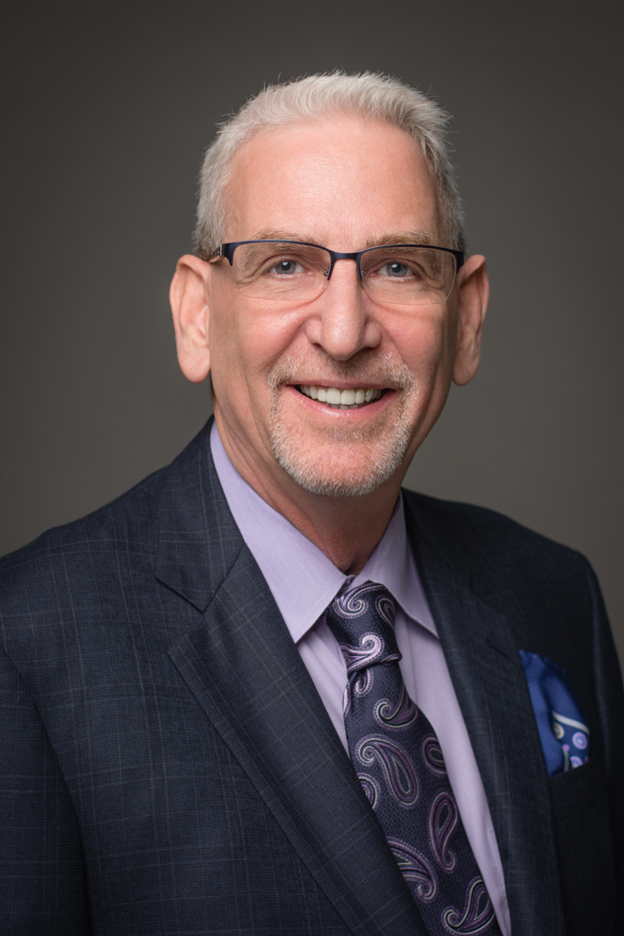

GENERAL SERVICE CONFERENCE
“Our Big Book – 80 Years,
71 Languages”
Rick McNamara, Area 16, Panel 68 Delegate – Report from:
69th

Slide 2

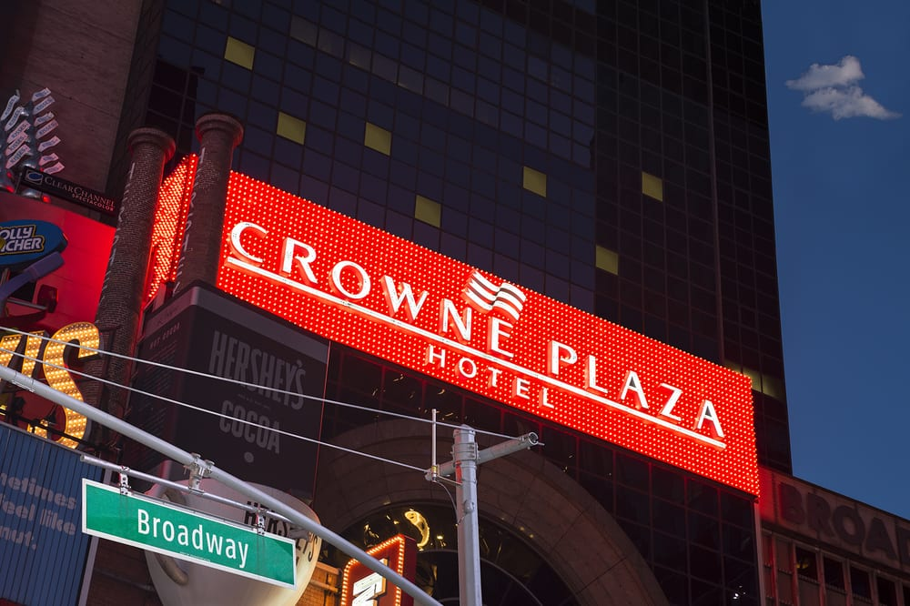
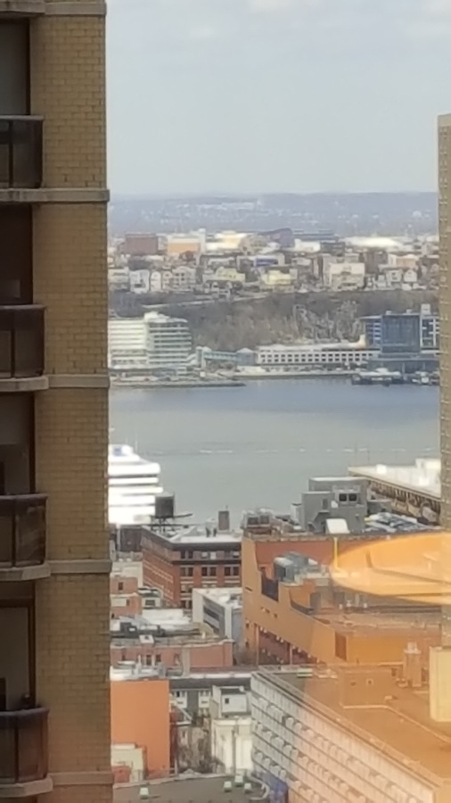
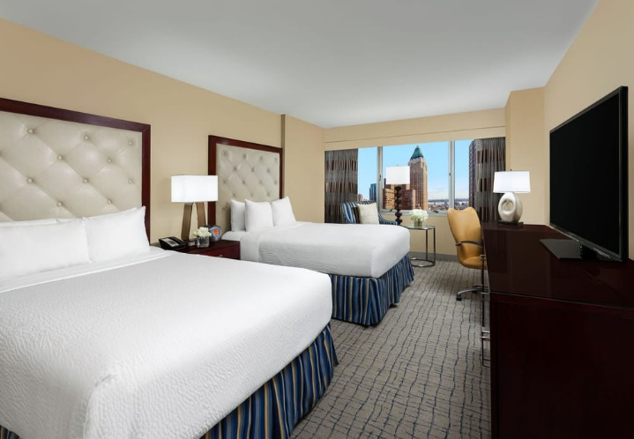
Home for the next week…
Crown Plaza Hotel, Times Square, New York City!

Slide 3





Special Thanks!!

Slide 4
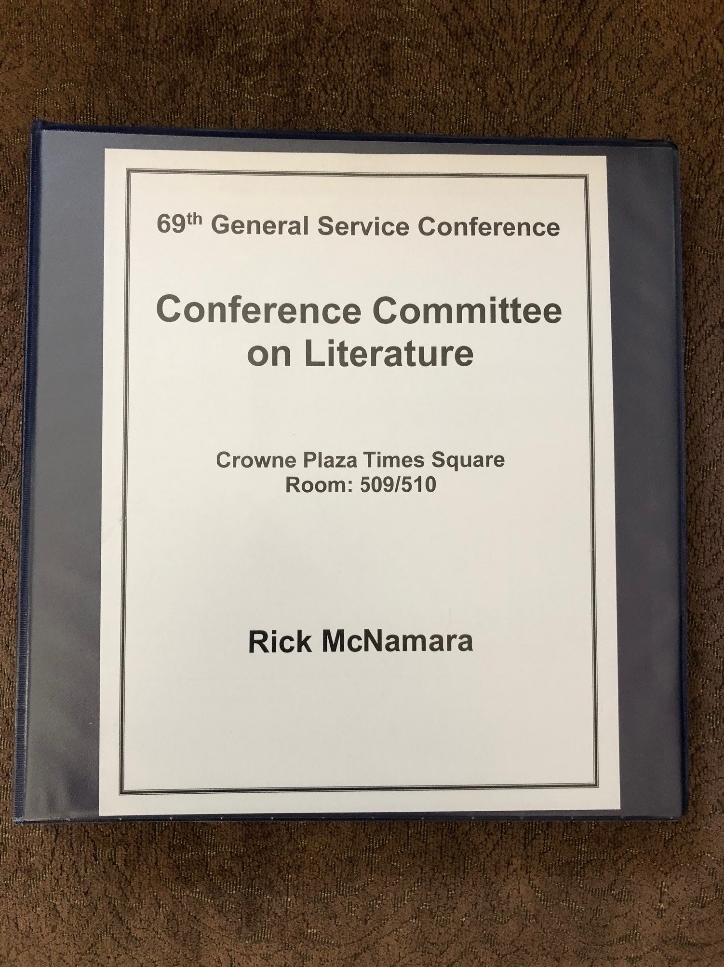
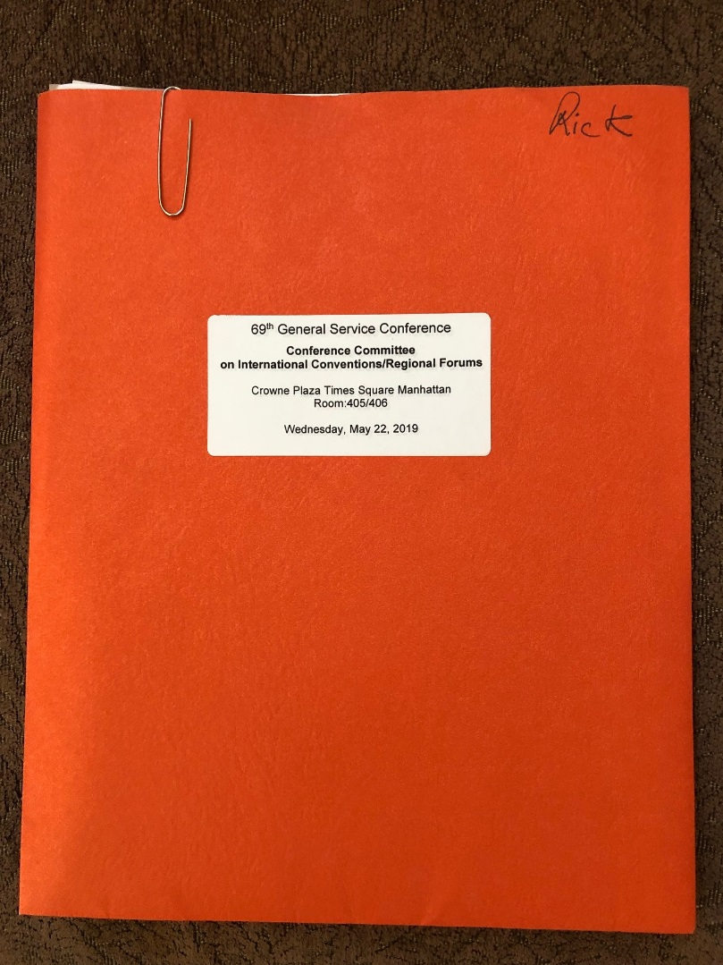
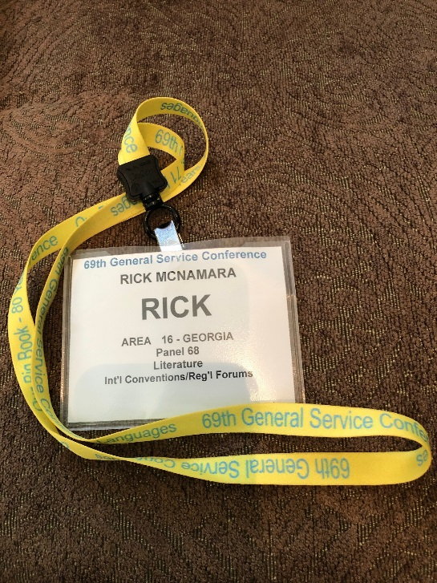
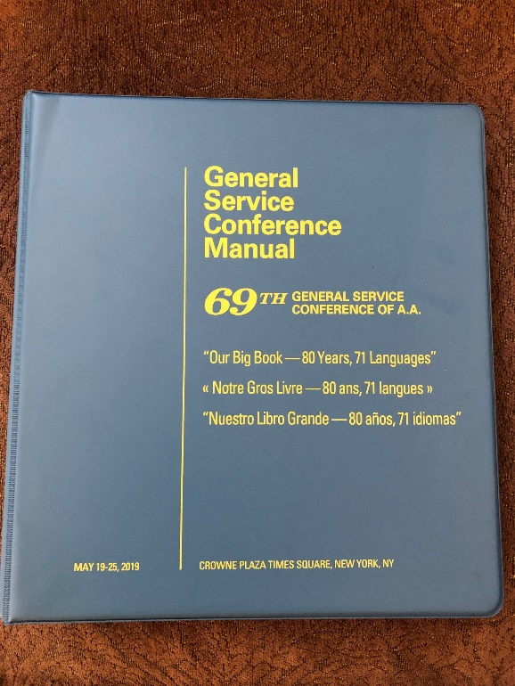
Committee Assignments

Slide 5
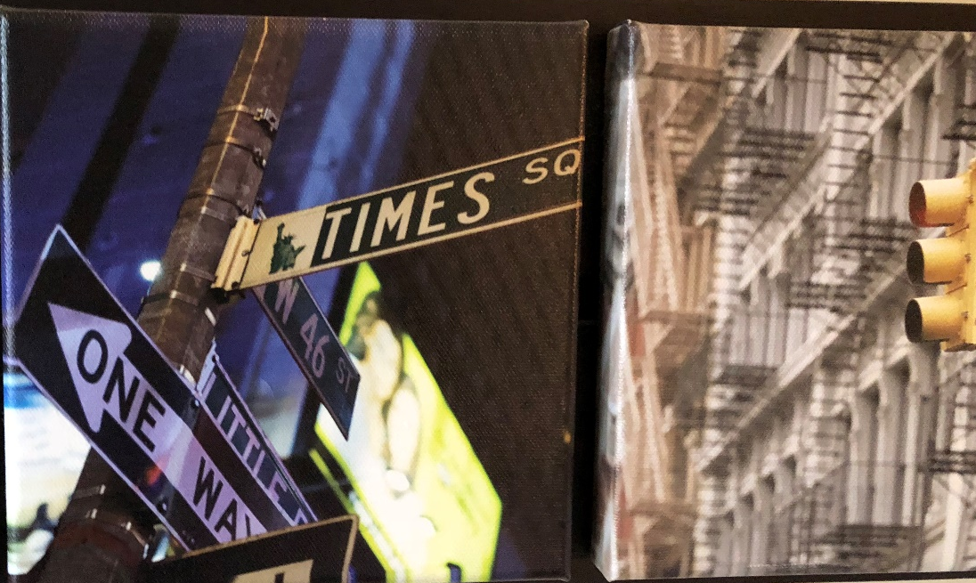
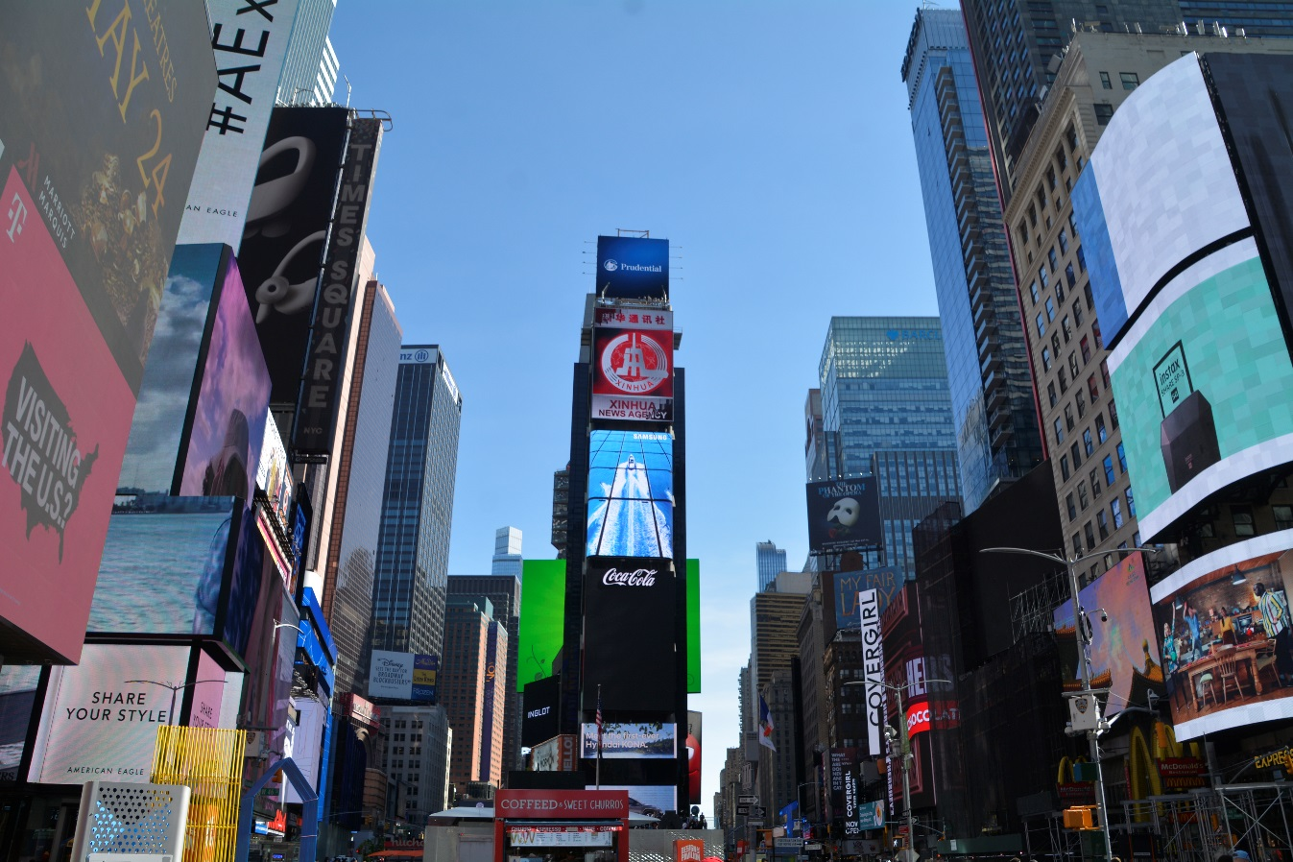
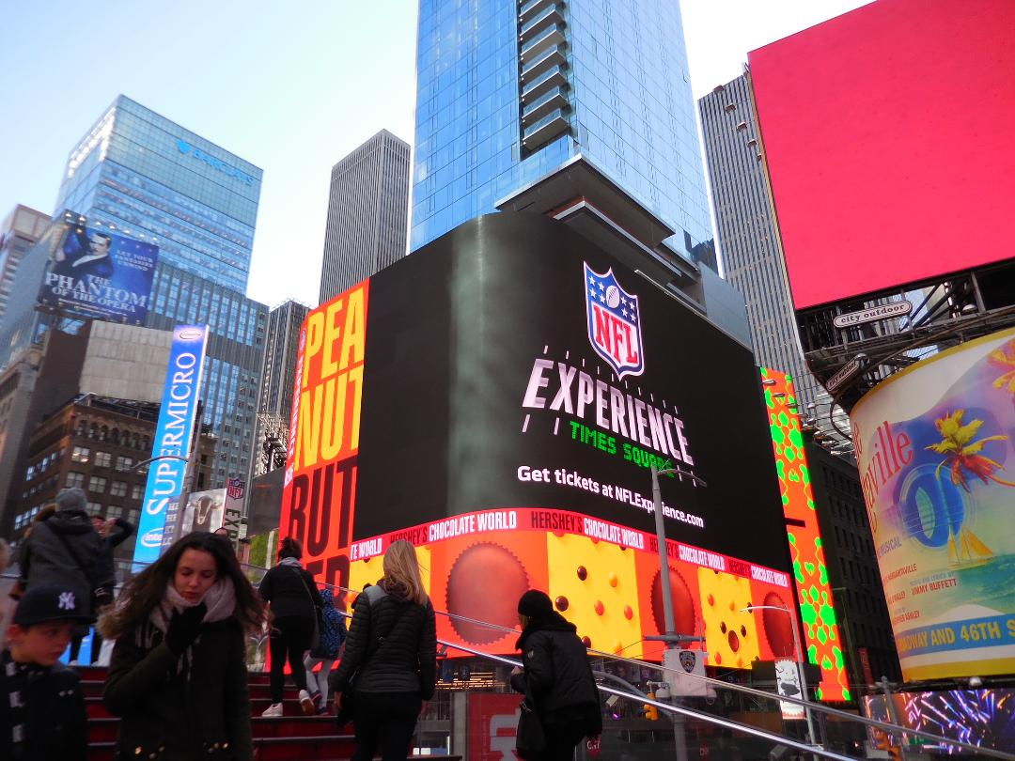
Before the Conference Starts…& Times Square

Slide 6


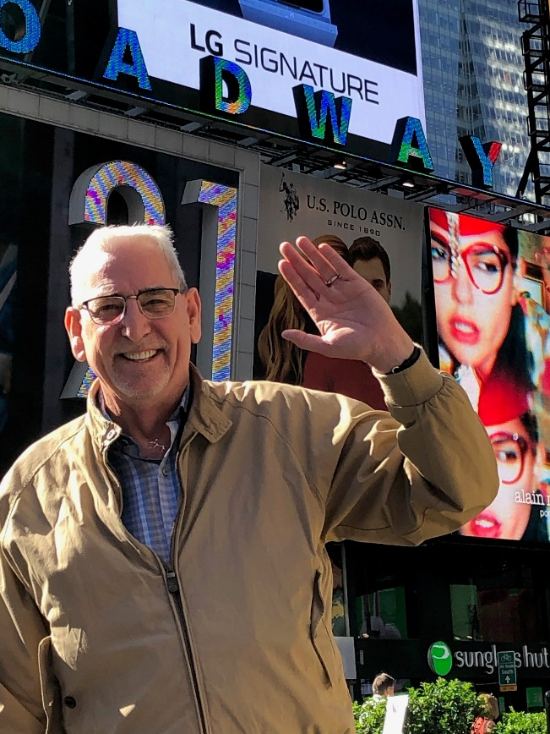
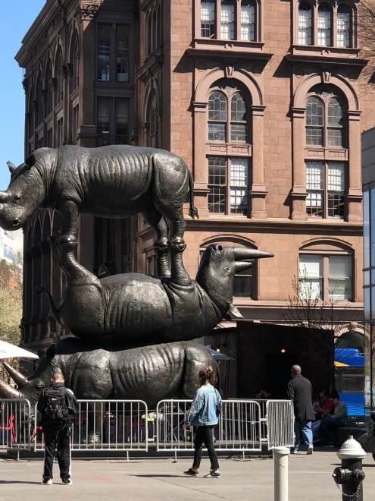
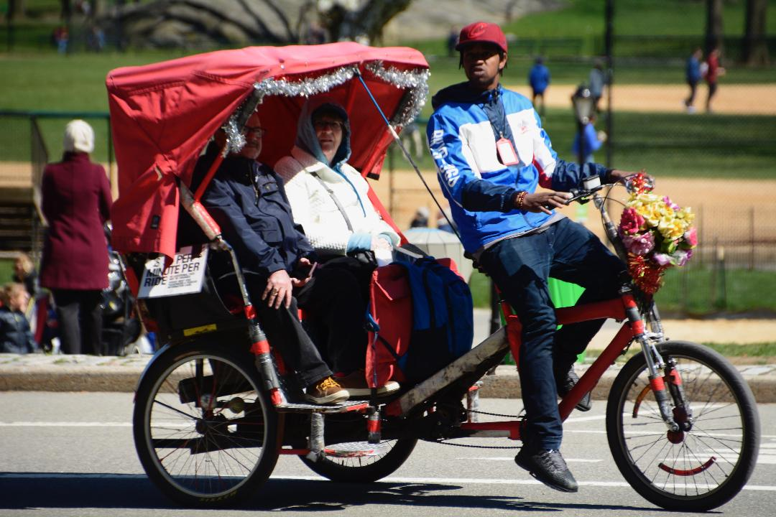
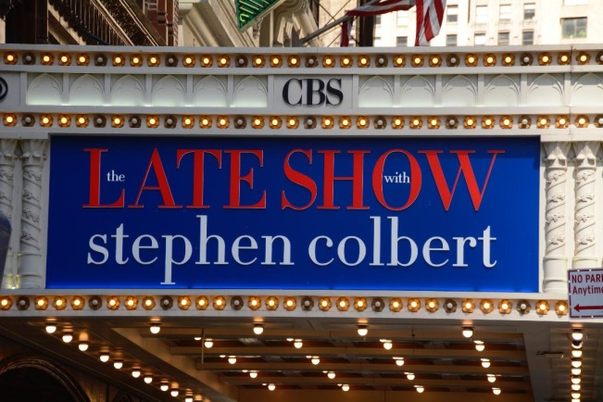
Before the Conference Starts…& Times Square

Slide 7
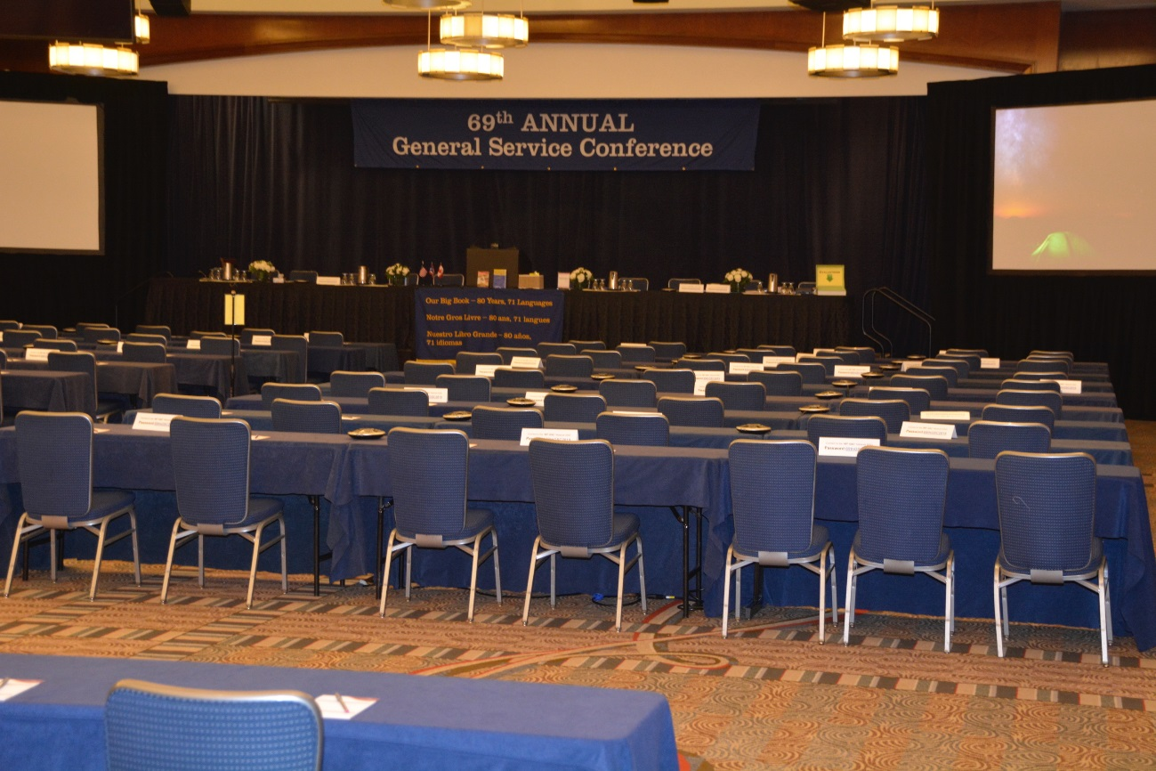
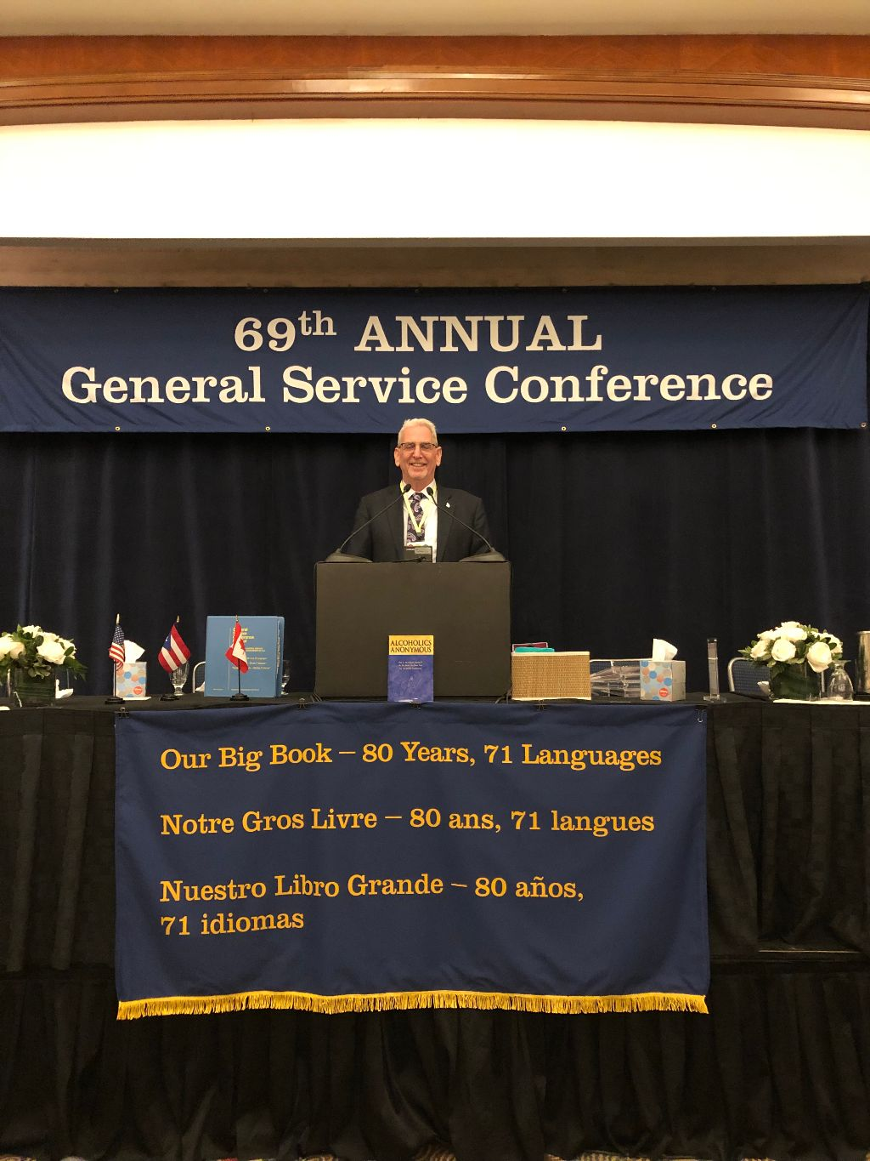

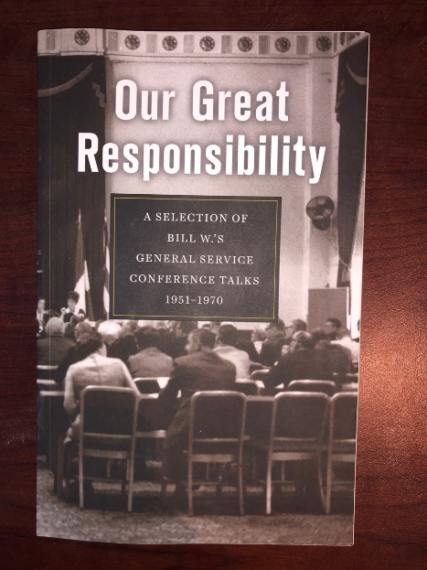
Opening Session

Slide 8
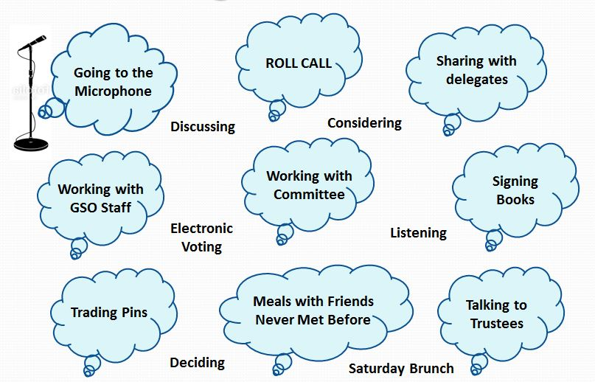
Spiritual Experiences…………..

Slide 9
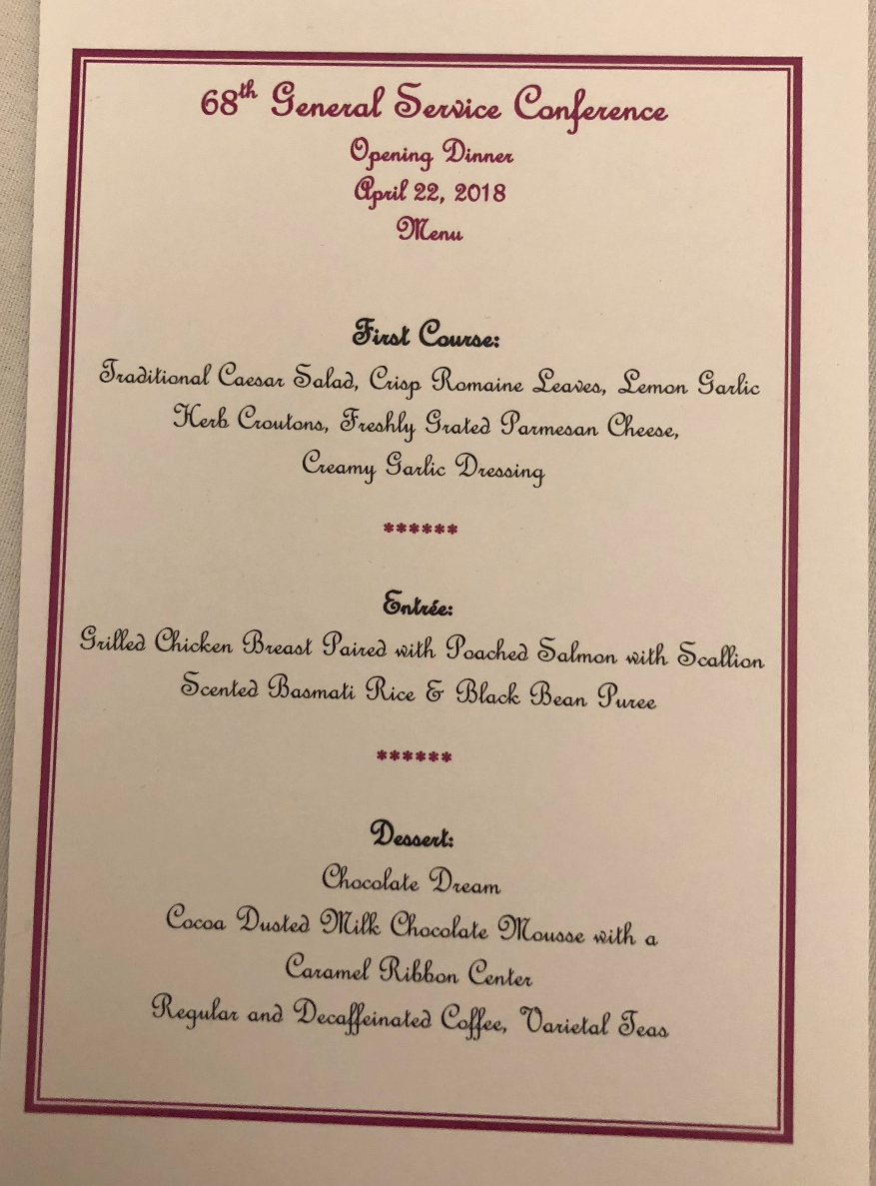
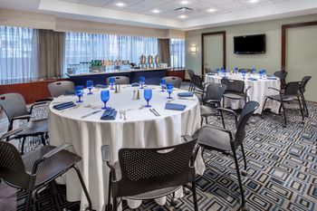
Dining Together

Slide 10
SUMMARY OF ACTIVITY* – 2018
$ - in Thousands | GSO | Publishing | Grapevine | La Viña | 2018 | 2017
REVENUE
Net Sales |  | 14,020 | 2,813 | 141 | 16,974 | 16,656
Contributions | 8,385 |  |  |  | 8,385 | 8,409
Interest |  |  | 31 |  | 31 | 20
TOTAL REVENUE | 8,385 | 14,020 | 2,844 | 141 | 25,390 | 25,085
EXPENSES
Cost of Goods Sold |  | 4,567 | 929 | 60 | 5,556 | 5,267
Operating (Program &
Supporting) Expenses | 11,427 | 6,016 | 2,064 | 229 | 19,736 | 18,059
TOTAL EXPENSES | 11,427 | 10,583 | 2,993 | 289 | 25,292 | 23,326
NET INCOME (LOSS) | (3,042) | 3,437 | (149) | (148) | 98 | 1,759
RESERVE FUND at December 31 |  |  |  |  | 15,935 | 14,353
Operating Expenses |  |  |  |  | 19,736 | 18,059
Number of months coverage |  |  |  |  | 9.7 | 9.5
* - Excludes Nonoperating Funds – Reserve, Capital Projects, Pension, Postretirement Medical Benefits
Notes:
Slide 4 – is the income statement of each of the operating entities for 2018. Ten (10) key amounts are highlighted in yellow: Finance Light Finance Complete
7th Tradition Contributions – $8,385,009 Slide 7 Slide 7 – Support 1
Recurring Operating Expenses – $19,736,206 Slide 24 Slide 24 – Support 1
GSO Service Expenses – $11,426,835 Slide 30 Slide 30 – Support 1
GSO Shortfall – $3,041,826 Slide 35 Slide 36 – Support 1
AAWS Net Sales – $14,020,149 Slide 41 Slide 41 – Support 1
AAWS Net Income – $3,436,507 Slide 41 Slide 41 – Support 1
Grapevine Net Loss – $149,167 Slide 51 Slide 51 – Support 1
General Fund Support – La Viña – $148,467 Slide 54 Slide 54
Reserve Fund – $15,935,331 Slide 60 Slide 60 – Support 1
Coverage Ratio – 9.7 months Slide 60 Slide 60 – Support 1

Slide 11
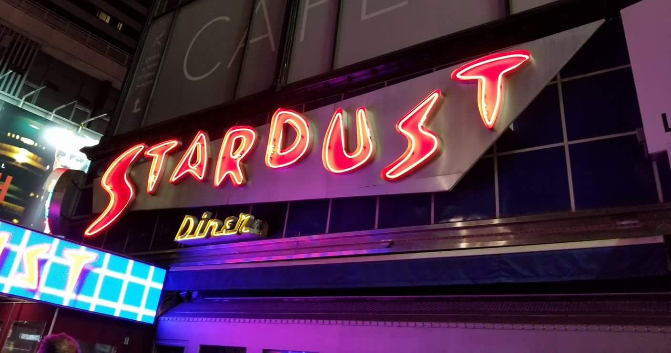
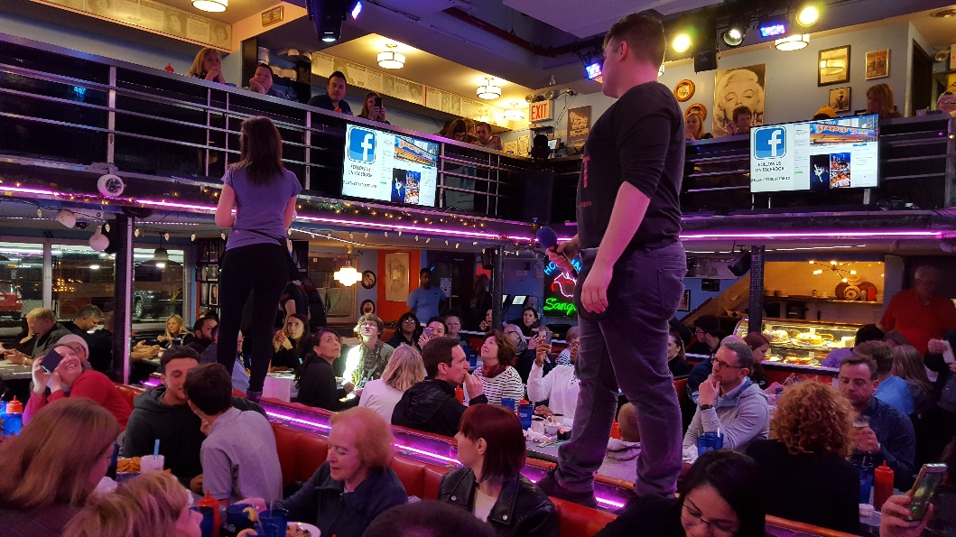
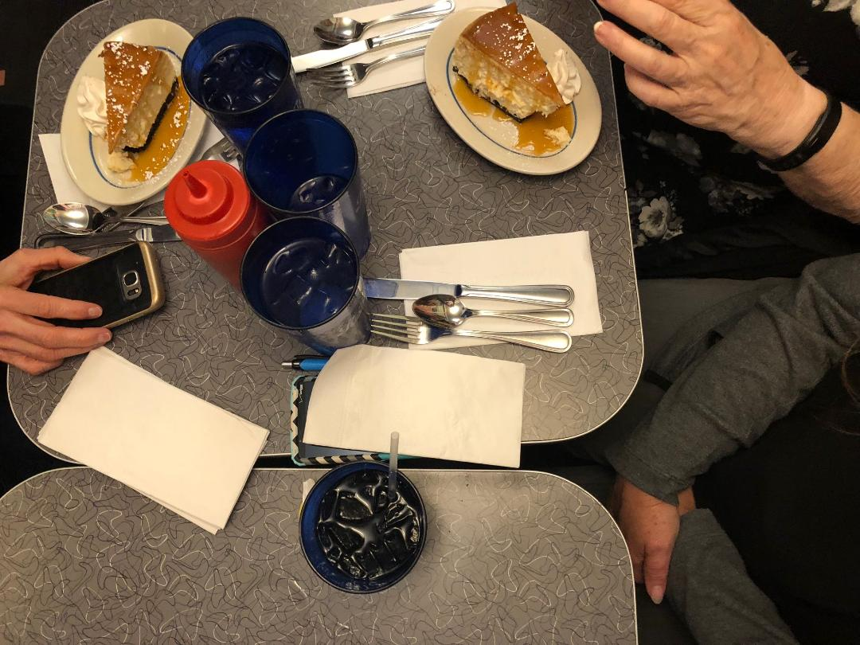
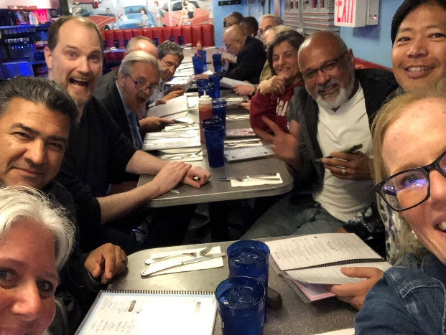
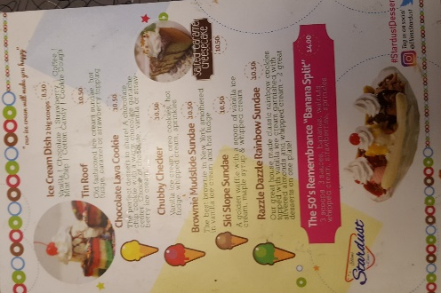
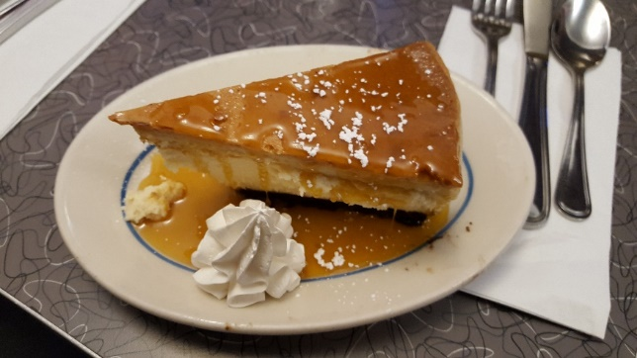
Tuesday Night – Regional Trustees treat the delegates…
Singing Wait staff
Ellen’s Stardust Diner
YUM!

Slide 12
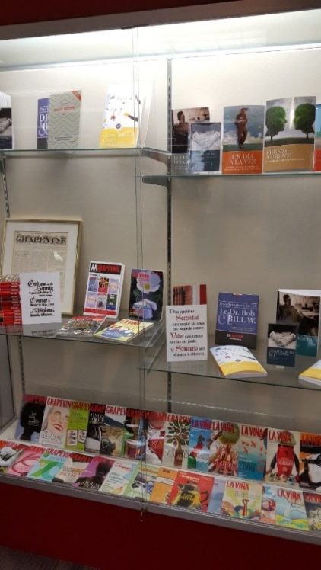
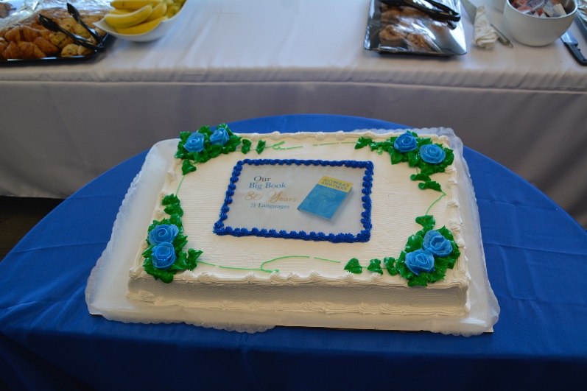
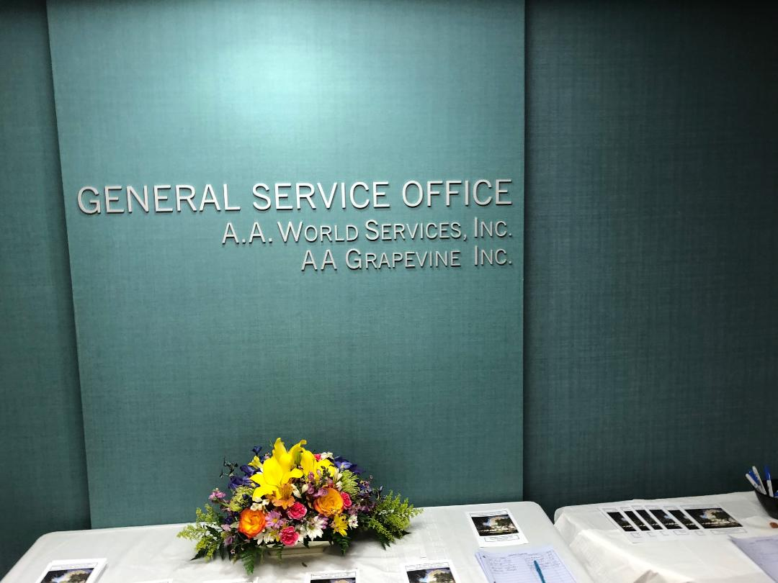
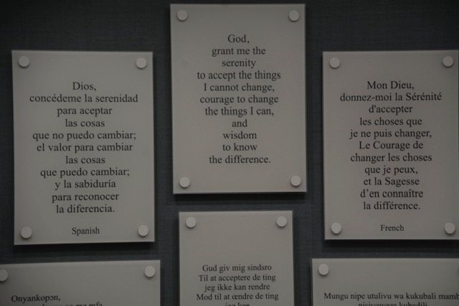
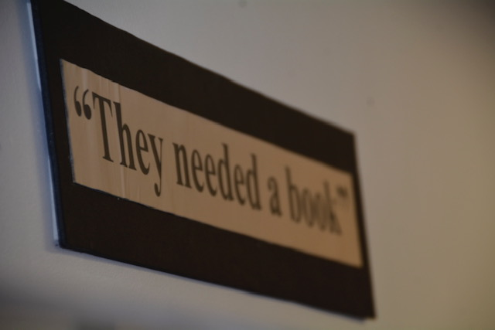
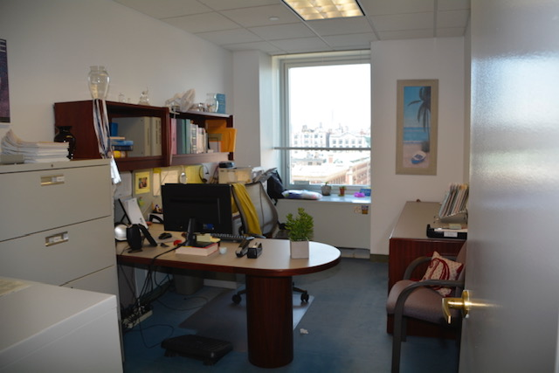
Wednesday Morning – Visit to GSO by Subway…
Display
Celebrate our Big Book!
GSO Lobby

Slide 13
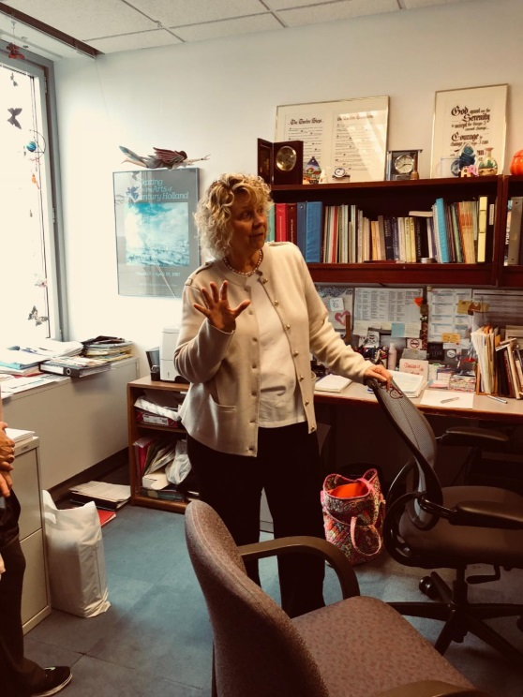
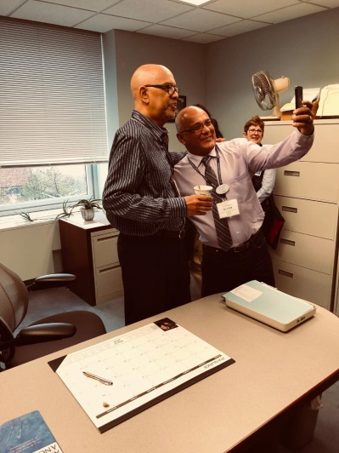
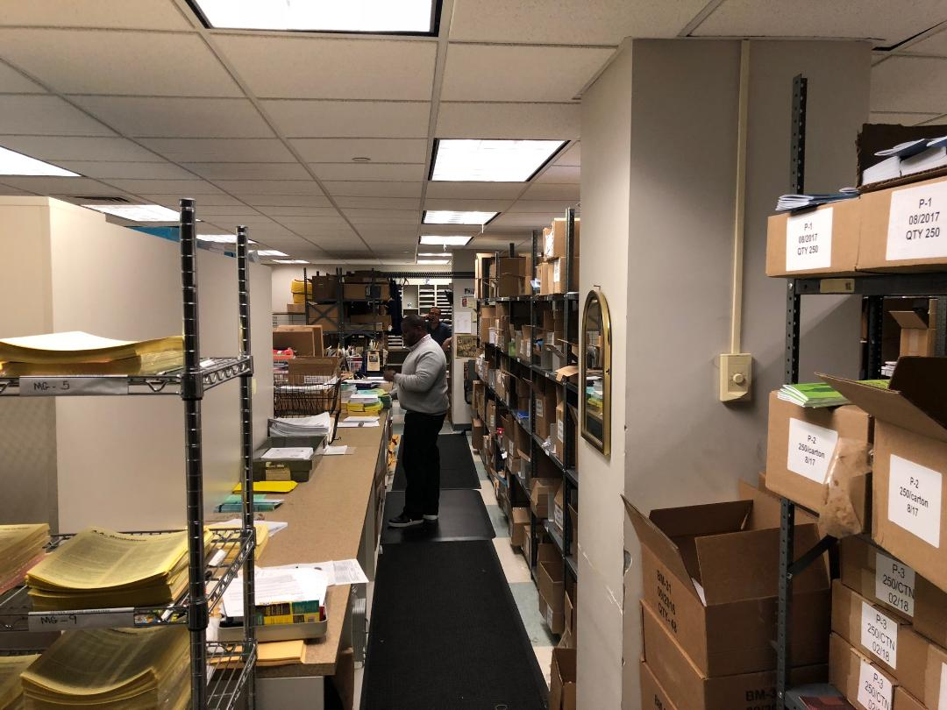
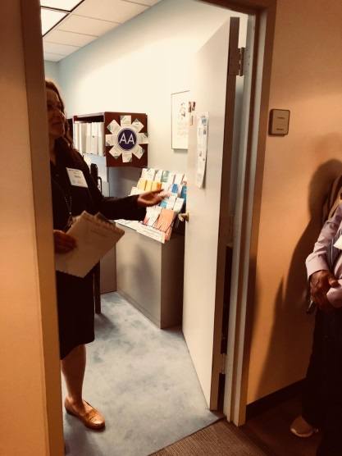
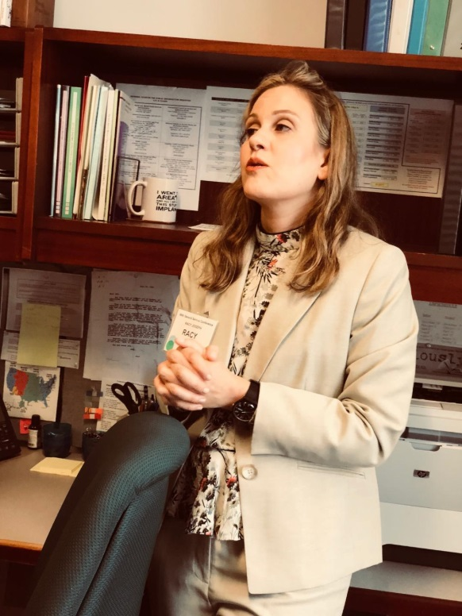
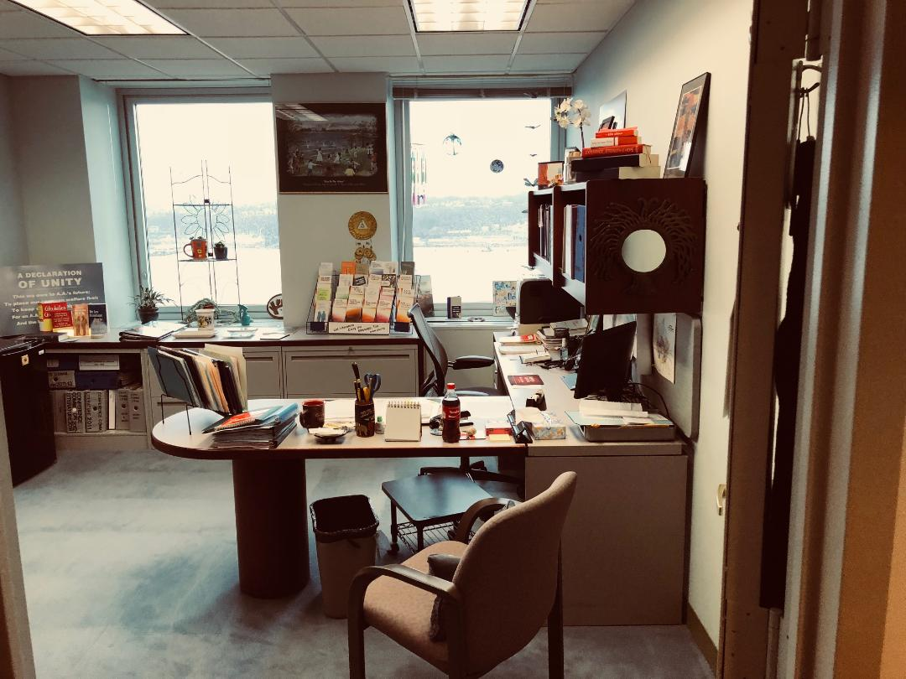
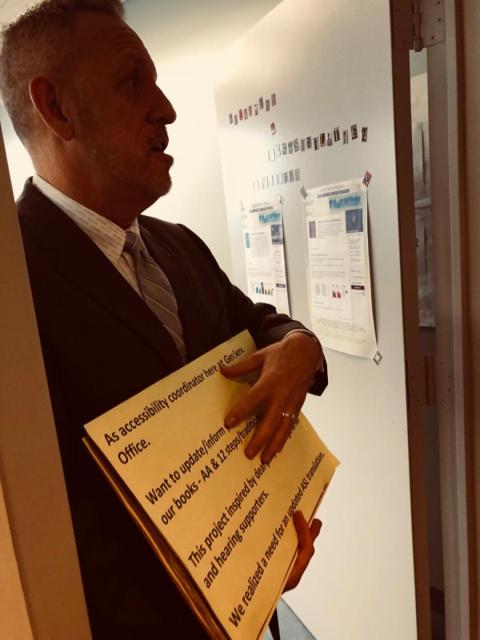
GSO Staff & Offices

Slide 14

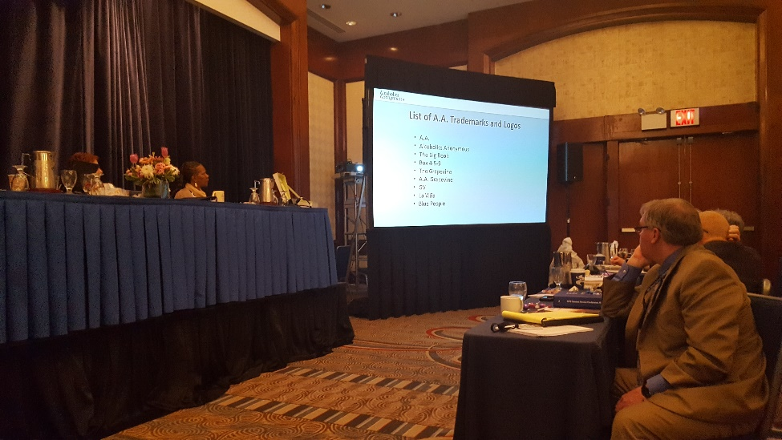
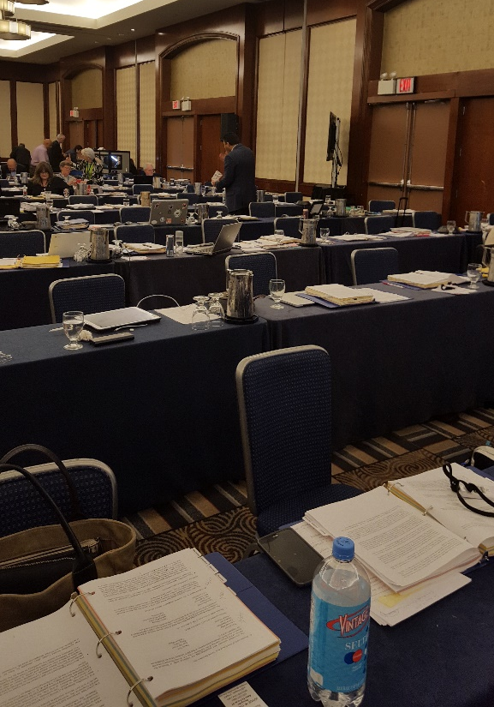
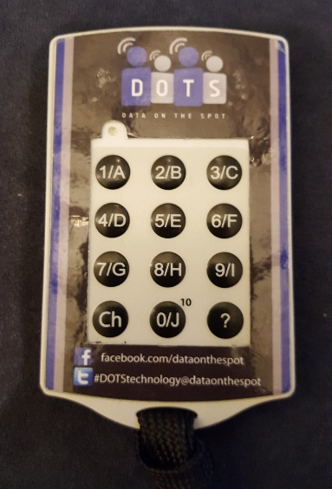

Committee Work Done…Full Conference Begins…
Electronic voting

Slide 15

AGENDA
Theme for the 2020 General Service Conference:
“A Clear Vison for You”
Presentation/Discussion Topics:
  Recovery – Who Is Missing in Our Rooms?
  Unity – Practicing Our Principles
  Service – Keeping A.A. Relevant
Notes:
Agenda
Review suggestions for the theme of the 2019 General Service Conference.
Review presentation/discussion topic ideas for the 2019 General Service Conference.
Review workshop topic ideas for the 2019 General Service Conference.
Review the General Service Conference Evaluation Form and 2017 Evaluation Summary.
Archives
Review Archives Workbook.
Cooperation with the Professional Community
Review contents of C.P.C. Kit and Workbook.
Corrections
Consider development of a new pamphlet focused on long-term incarcerated alcoholics soon to be released.
Review contents of Corrections Kit and Workbook.
Grapevine
Review Audio Strategy status update.
Consider list of suggested Grapevine book topics for 2019 or later.
Review Grapevine Workbook.
International Conventions/Regional Forums
Discuss ways to encourage interest in Regional Forums and attract first-time attendees.
Literature
Consider request to add an appendix to Alcoholics Anonymous reflecting “recognition received from the Library of Congress.”
Consider request to add the A.A. Preamble and Responsibility Statement to Alcoholics Anonymous.
Review annual matrix of recovery literature.
Consider request that A.A. World Services, Inc. publish “The God Word” (a pamphlet currently published by The General Service Board Great Britain).
Consider request for the development of a pamphlet for atheist/agnostic members.
Consider request for the development of a pamphlet based upon A.A.’s Three Legacies.
Review report and suggestions on the inclusion of language regarding safety in recovery literature.
Policy/Admissions
Review draft process of polling the General Service Conference between annual Conference meetings.
Review dates for the 2021 General Service Conference.
Public Information
Review 2017 annual report from the trustees’ Public Information Committee regarding aa.org and aagrapevine.org.
Review Young People’s Video submission.
Review 2018 Public Information Comprehensive Media Plan.
Review contents of P.I. Kit and Workbook.
Report and Charter
The A.A. Service Manual, 2018-2020 Edition:
Review list of editorial updates.
Consider request for changes to chapters 2, 3, and 5 in The A.A. Service Manual.
Consider developing a plan with a revised editorial review process for The A.A. Service Manual.
Discuss A.A. Directories.
Discuss General Service Conference Final Report.
Treatment and Accessibilities
Review contents of Treatment Committee Kit and Workbook.
Review contents of Accessibilities Kit and Workbook.
Trustees
Review resumes of candidates for:
Eastern Canada Regional Trustee
Pacific Regional Trustee
Review slates of trustees and officers of the General Service Board of Alcoholics Anonymous, Inc.
Review slate of directors of A.A. World Services, Inc.
Review slate of directors of A.A. Grapevine, Inc.
Review proposal to censure the General Service Board.
Review proposal to reorganize the A.A. World Services and General Service Boards.

Slide 16
AGENDA
Workshop Topic for the 2020 General Service Conference:
  Attraction Through Action
Notes:
Agenda
Review suggestions for the theme of the 2019 General Service Conference.
Review presentation/discussion topic ideas for the 2019 General Service Conference.
Review workshop topic ideas for the 2019 General Service Conference.
Review the General Service Conference Evaluation Form and 2017 Evaluation Summary.
Archives
Review Archives Workbook.
Cooperation with the Professional Community
Review contents of C.P.C. Kit and Workbook.
Corrections
Consider development of a new pamphlet focused on long-term incarcerated alcoholics soon to be released.
Review contents of Corrections Kit and Workbook.
Grapevine
Review Audio Strategy status update.
Consider list of suggested Grapevine book topics for 2019 or later.
Review Grapevine Workbook.
International Conventions/Regional Forums
Discuss ways to encourage interest in Regional Forums and attract first-time attendees.
Literature
Consider request to add an appendix to Alcoholics Anonymous reflecting “recognition received from the Library of Congress.”
Consider request to add the A.A. Preamble and Responsibility Statement to Alcoholics Anonymous.
Review annual matrix of recovery literature.
Consider request that A.A. World Services, Inc. publish “The God Word” (a pamphlet currently published by The General Service Board Great Britain).
Consider request for the development of a pamphlet for atheist/agnostic members.
Consider request for the development of a pamphlet based upon A.A.’s Three Legacies.
Review report and suggestions on the inclusion of language regarding safety in recovery literature.
Policy/Admissions
Review draft process of polling the General Service Conference between annual Conference meetings.
Review dates for the 2021 General Service Conference.
Public Information
Review 2017 annual report from the trustees’ Public Information Committee regarding aa.org and aagrapevine.org.
Review Young People’s Video submission.
Review 2018 Public Information Comprehensive Media Plan.
Review contents of P.I. Kit and Workbook.
Report and Charter
The A.A. Service Manual, 2018-2020 Edition:
Review list of editorial updates.
Consider request for changes to chapters 2, 3, and 5 in The A.A. Service Manual.
Consider developing a plan with a revised editorial review process for The A.A. Service Manual.
Discuss A.A. Directories.
Discuss General Service Conference Final Report.
Treatment and Accessibilities
Review contents of Treatment Committee Kit and Workbook.
Review contents of Accessibilities Kit and Workbook.
Trustees
Review resumes of candidates for:
Eastern Canada Regional Trustee
Pacific Regional Trustee
Review slates of trustees and officers of the General Service Board of Alcoholics Anonymous, Inc.
Review slate of directors of A.A. World Services, Inc.
Review slate of directors of A.A. Grapevine, Inc.
Review proposal to censure the General Service Board.
Review proposal to reorganize the A.A. World Services and General Service Boards.

Slide 17
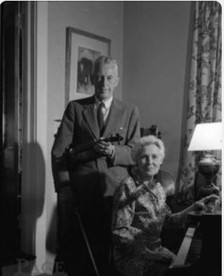
ARCHIVES
The 1940s home movie of the co-founders and their wives be added to the Archives video “Markings on the Journey” at an estimated cost of $5,000.
.

Slide 18
COOPERATION WITH THE PROFESSIONAL COMMUNITY
  It was recommended that:
  The text “They may help arrange hospitalization” be removed from the section “What can you expect from A.A.?” in the pamphlet “Alcoholics Anonymous in Your Community.”

Slide 19
CORRECTIONS
No Recommendations

Slide 20
FINANCE
It was recommended that:
The level of $5,000 for individual bequests to the General Service Board from A.A. members be raised to $10,000.

Slide 21
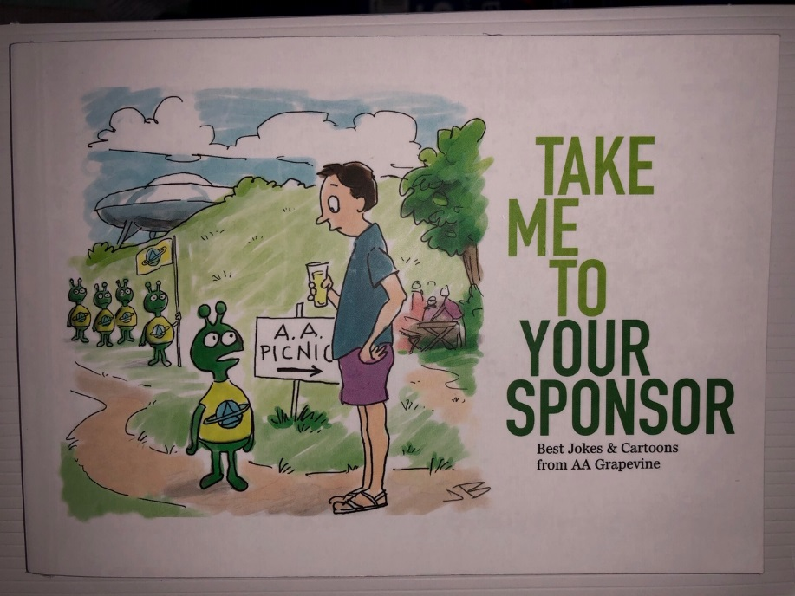
GRAPEVINE
LA VIÑA
No Recommendations

Slide 22

INTERNATIONAL CONVENTION /
REGIONAL FORUMS
It was recommended that:
An anonymity-protected photograph of the flag ceremony be taken at the 2020 International Convention.
An anonymity-protected Internet broadcast of the 2020 International Convention Opening Flag Ceremony be approved.
Anonymity-protected video footage with highlights of the 2020 International Convention be produced for maintaining archival footage of the Convention, as well as for sharing the spirit and enthusiasm of the 2020 International Convention.

Slide 23
LITERATURE
It was recommended that:
A. The pamphlet “Questions and Answers on Sponsorship” be revised to add the following text regarding anonymity:
  1. Under the section, “What does a sponsor do and not do?” (p. 13), after the current bullet “Impresses upon the newcomer the importance of all our Traditions,” add a new bullet with the following language: Emphasizes the relevance and spiritual value of anonymity, both on a person to person basis, as well as at the public level including social media. (For more information see the pamphlet, “Understanding Anonymity”).
  2. Under the section, “How can a sponsor explain the A.A. program?” (p. 15), add a 6th paragraph: Many sponsors discuss the significance of anonymity at a personal level and public level early on. Anonymity at a personal level provides protection for all members from the identification as alcoholics, a safeguard often of special importance to newcomers. At the public level of press, radio, films, and other media technologies, such as the internet, anonymity stresses the equality in the Fellowship of all members by putting the brake on those who might otherwise exploit their A.A. affiliation to achieve recognition, power, or personal gain. The sponsor is quick to point out the benefit of anonymity at this public level. Sponsors may provide examples from their own experience of maintaining public anonymity.
B. The trustees’ Literature Committee update the pamphlet “The Twelve Steps Illustrated” and bring back a progress report or draft pamphlet to the 2020 General Service Conference.
C. The trustees’ Literature Committee update the pamphlet “The Twelve Concepts Illustrated” and bring back a progress report or draft pamphlet to the 2020 General Service Conference.

Slide 24
POLICY/ADMISSIONS
Revise “Process for polling the GSC between Conference meetings” to add a 7 day discussion period before voting opens

Slide 25
PUBLIC INFORMATION
The “Policy on Actors Portraying A.A. Members or Potential A.A. Members in Videos Produced by the General Service Board or its Affiliates” be reaffirmed.
Two PSAs be developed at a cost not to exceed $50,000 for each PSA, and that if full-face characters are shown, to include an “actor portrayal” disclaimer on screen.
  The text addressing anonymity and safety be included in the pamphlet “Understanding Anonymity” as follows:
    Q. Is it okay to tell someone if I witness or experience inappropriate behavior that happens either during or outside meeting times? Can I alert the proper authorities if there is criminal behavior?
    A. Groups strive to provide as safe an environment as possible in which members can focus on sobriety, and, while anonymity is central to that purpose, it is not intended to be a cloak protecting inappropriate or criminal behavior. Saying something about inappropriate behavior or calling the proper authorities does not go against any A.A. Traditions and is meant to preserve the safety of all members.
  A progress report on the usefulness and effectiveness of the A.A.W.S. YouTube channel be brought back to the 2020 Conference Committee on Public Information.
A.A. World Services, Inc. implement Google AdWords/ Grants for the purpose of providing information about A.A. to the public and that a report be brought back to the 2020 Conference Committee on Public Information.

Slide 26
REPORT & CHARTER
No Recommendations

Slide 27
TREATMENT & ACCESSIBILITIES
It was recommended that:
Ashley’s story (an A.A. member who is Deaf) be added to the pamphlet “Access to A.A.: Members Share on Overcoming Barriers” and that the video version of the pamphlet be updated to reflect this change.
2. The pamphlet “A.A. for the Older Alcoholic – Never Too Late” be updated with a revised introduction; current and inclusive stories; reference to online A.A.; and an updated “How Do I Find A.A.?” section. The committee requested that a progress report or draft pamphlet be brought back to the 2020 Conference Committee on Treatment and Accessibilities.
3. The trustees’ Committee on Cooperation with the Professional Community/ Treatment and Accessibilities develop anonymity-protected audio interviews with military professionals about their experience with A.A. as a resource for posting online.

Slide 28
TRUSTEES
Please see Slate of approved Trustees in Report

Slide 29
Floor Actions
#1 - Start work on a 4th edition Spanish Big Book: Sent to trustees’ Literature committee
#2 - Prioritize production of Spanish audio version of The Language of the Heart: FAILED
#3 - Add “The God Word” pamphlet to the Corrections literature - DECLINED TO CONSIDER
#4 - Update “A.A. for the Black and African-American Alcoholic”: Sent to trustees’ Literature committee
#5 - Prominently include simple majority suggestions in the Conference Final Report: FAILED
#6 - Remove “Alcoholism at Large” section from A.A. Grapevine: DECLINED TO CONSIDER
#7 - Recommit AAWS “Policy on Publication of Literature: Updating Pamphlets and Other A.A. Materials” to the trustees’ Literature committee with an updated policy to be brought back to the 70th GSC: PASSED

Slide 30
Recommendations Not Resulting in Conference Advisory Actions
Literature:
The phrase “Nonalcoholics may attend open meetings as observers” be added as the final sentence to the “Open Meeting” side of the Primary Purpose (Blue) Card. The card will read as follows (Bold text reflects addition):
THIS IS AN OPEN MEETING OF ALCOHOLICS ANONYMOUS This is an open meeting of Alcoholics Anonymous. We are glad you are all here — especially newcomers. In keeping with our singleness of purpose and our Third Tradition which states that “The only requirement for A.A. membership is a desire to stop drinking,” we ask that all who participate confine their discussion to their problems with alcohol. Nonalcoholics may attend open meetings as observers.
A draft Fifth Edition of Alcoholics Anonymous be developed and a progress report be brought to the 2020 Conference Literature Committee, keeping in mind the 1995 Advisory Action that: The first 164 pages of the Big Book, Alcoholics Anonymous, the Preface, the Forewords, “The Doctor’s Opinion,” “Dr. Bob’s Nightmare,” and the Appendices remain as is.

Slide 31
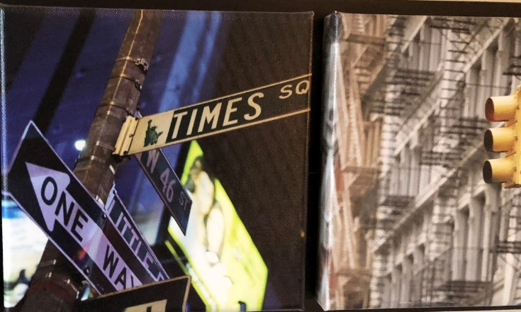
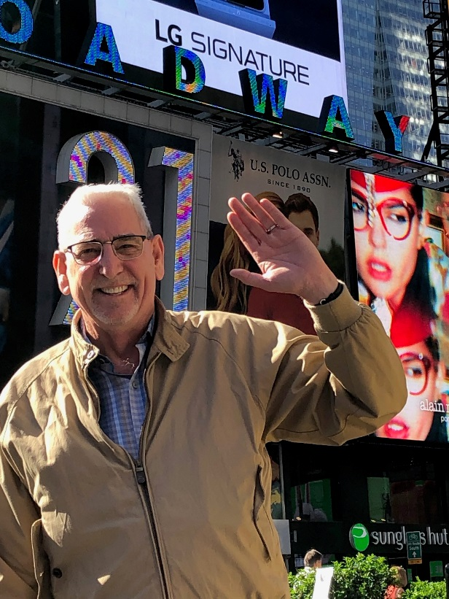
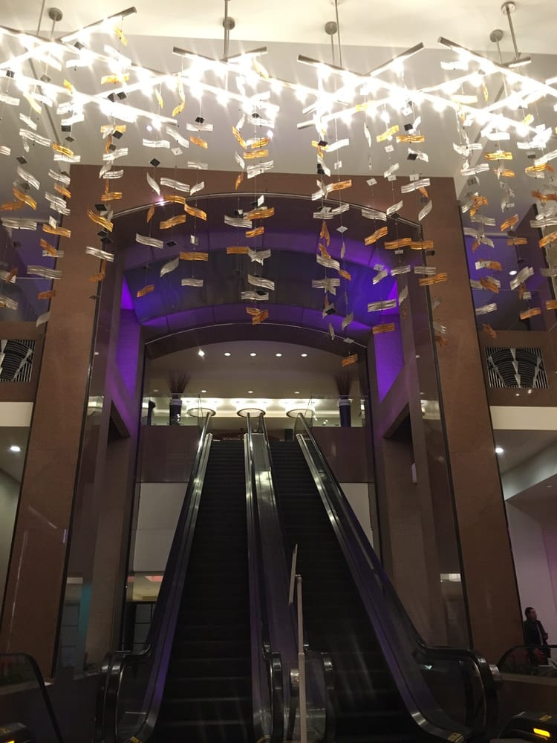
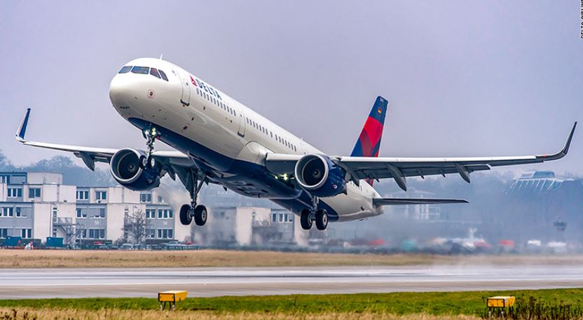
We finished the work you sent us to do …so it is time to say goodbye!
Goodbye…to:
Long productive days
Friends, Old & New
GSO Staff
Delegates
Trustees
Times Square
Crown Plaza
Hello…to:
Family
LaGuardia Airport
Delta Airlines
& Atlanta

Slide 32

Thank You!

