Slide 1


Slide 2



70th General Service Conference
A Clear Vision for you

Slide 3

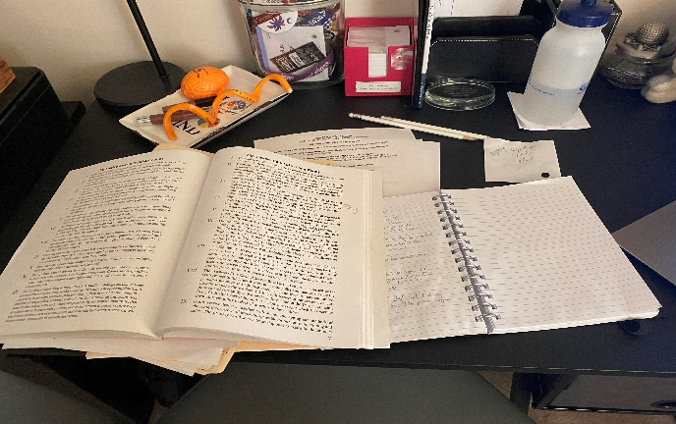
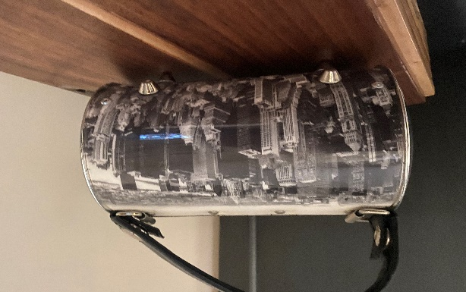
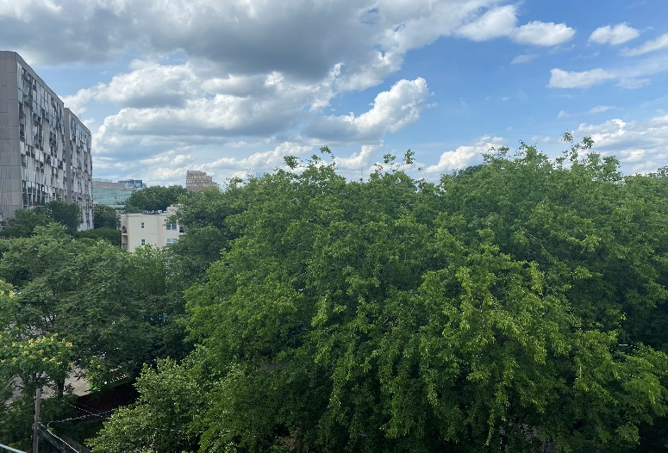

What I Saw, Heard, and Felt

Slide 4
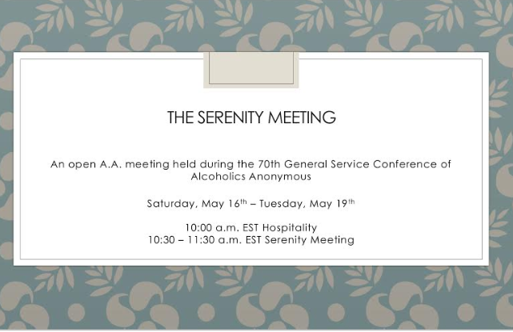
Starting the day…

Slide 5

Agenda Review Process
Consider the following:
  Whether the agenda item is time-sensitive
  Whether there is enough time to fully consider a large policy consideration
  Whether the Conference can offer the time required for fully informed discussion that is deserved by so many of the policy considerations on the table
  Remote discussion and debate moves slower than in real time
  Balance of the report, time for questions, and any debate or voting required
Notes:
Conference was 4 days with no more than 6 hours a day, although we did go over that time
3 hours of committee time-1 hour for secondary committees
45 minutes for report, discussion, and voting

Slide 6
Ch-Ch-Ch-Changes…
Floor Actions- Floor actions would be forwarded to trustees’ Committee on the General Service Conference unless a Motion to Decline passed.
Reporting- Committee oral reports would be limited to Advisory Actions. Committee Considerations would be reported, if time permitted. Each Conference Committee had 45 minutes for reporting, discussion, and voting.
Time to speak – Conference members had one minute “at the mike” for questions/comments.

Slide 7
Understanding the “Lingo”
Advisory Actions
Recommendations made by the Conference Committee and shared, discussed , and voted on with substantial unanimity by the conference voting members.
Committee Considerations
Items discussed but no action taken or recommendation made. Committee recommendations which are not adopted must be included in a separate section in the Final Conference Report.
Took No Action
A committee may decide not to discuss an Agenda item. If a decision to take no action is made at the virtual Conference, the Agenda item is not forwarded.
Notes:
Advisory Actions are accepted by the GSB at its required meeting immediately following the Conference. These are the items the Board will work to complete over the next year.
Committee Considerations- from a 1990 Advisory Action requiring these items to be included in Final Conference Report. These provide suggestions and guidance on how best to carry the message.
For the 70th GSC, all Floor Actions would be forwarded to the 71st GSC by agreed-upon procedural changes. However, any item that falls within the scope of a Conference Committee should go through the that Conference Committee so that the topic may receive due consideration. There was actually an Agenda item in the Policy/Admissions Committee to review the Floor Action process. This item was forwarded to the 71st GSC.

Slide 8

I. Agenda
A. The 71st General Service Conference Theme”
  2021-A.A. in a Time of Change
B. Presentations:
  Recovery in a Changing World
  Unity in a Changing World
  Service in a Changing World
C. Workshop topics:
  Inform- Communicate
  Involve -Act
  Inspire- Attract PASSED
Notes:
No Committee Considerations

Slide 9
I. Agenda –Forwarded to 71St GSC
Review the GSC Evaluation Form, process, and 2019 Evaluation Summary.
Review the 2019 January Conference Call survey participant results.
Discuss report on the Conference Agenda Process from the Trustee’s Committee on the GSC.
Discuss the General Service Conference Schedule.
Notes:
No committee considerations

Slide 10

II. Cooperation with Professional Community
No Advisory Actions
Committee Considerations-
  Consider a request to discontinue the pamphlet “A.A. in Your Community” –TOOK NO ACTION
  Committee noted- Update of
    language and style needed; focus on modern settings and various formats such as digital resources
  Vital to CPC Committee Work
    Introduces professionals to
    A.A. as a community resource
Notes:
Digital resources to include: Meeting Guide App, You Tube Channels Linked In page

Slide 11


II. CPC: Forwarded to the 71st GSC
  Consider a request to create a pamphlet for mental health professionals
  Discuss progress report on LinkedIn page implementation, activity, comments, changes and updates, modernized content, posting videos and webinars, etc. (7 items)
  Review contents of CPC Kit and Workbook

Slide 12

III. Corrections
No Advisory Actions
Thorough review of Corrections Kit and Workbook; provided a list of recommended changes to reflect current practices and resources
Committee Considerations- The Committee heard a report on efforts to provide digital distribution of A.A. literature in correctional facilities . Several viable options are being explored.
Update on staple-free pamphlets
Addition of “The God Word” Pamphlet to contents of Corrections Kit
No items forwarded
Notes:
Moving forward to make the most widely used pamphlets in correctional facilities staple-free. I was honored to be elected chair for the Conference Committee on Corrections for the 71st GSC.

Slide 13

IV. Finance
Advisory Action- Add draft language related to the “virtual basket” to the pamphlet, “Self-Support: Where Money and Spirituality Mix”. PASSED
Notes:
Some members of our group wanted to pass a “virtual basket” to collect Seventh Tradition contributions digitally. How could we do this?
A. A number of groups have utilized digital payment platforms as an adjunct to passing the basket in the conventional sense in order to provide opportunities for cashless contributions. There are different payment platforms to facilitate this service and it is up to the group to determine which one to use. Some groups have found that a smartphone app-based payment platform is the most efficient, seamless and minimally disruptive solution for providing a digital contribution. Experience suggests that the treasurer is a likely choice to handle digital contributions, though some groups add more than one trusted servant to share the responsibilities or create a new service position to inform the group about digital payment options and assist other group members who are interested in contributing this way.

Slide 14


IV. Finance
Committee Consideration:
  The committee reviewed a request to revise the pie chart on page 12 of the pamphlet, “Self-Support: Where Money and Spirituality Mix” and TOOK NO ACTION as the percentages provided are suggested.
  The committee reviewed a report from the trustees’ Finance Ad Hoc Committee on Google Ad Grants and the Seventh Tradition. The committee strongly suggests forwarding this report to the trustees’ Finance and Budgetary Committee and the appropriate 71st GSC committee.

Slide 15

IV. Finance: Floor Action
That the Finance Committee expand Agenda item #2 that will be forwarded to the trustees’ Conference Committee to include the proposal to revise the pie chart percentages in order to emphasize more clearly that any percentages included in the pamphlet are only suggestions and examples, not recommendations.
  Motion to decline failed
Notes:
A floor action could be made at the end of a Committee report. When a floor action is made, the chair asks the body if there is a motion to decline consideration of the Floor action. If the motion to decline passes, the floor action is not longer considered. If the motion to decline fails, for the virtual conference, all floor actions would be forwarded to the 71st GSC.

Slide 16

IV. Finance: Floor Action
  The launch of Google AdWords Grants be halted until the 71st GSC convenes and approves that launch and that the “Ad Hoc Committee Progress Report-Google Grants and the 7th Tradition,” from the trustees’ Finance Committee be immediately released to all members of the 7oth GSC.
  Motion to decline failed.
Notes:
the “Ad Hoc Committee Progress Report – Google Grants and the 7th Tradition”, from the trustees Finance Committee, dated 3/30/2020, be immediately released to the members of the 70th GSC.

Slide 17


IV. Finance: Forwarded to the 71st GSC
Consider a request regarding contribution percentages to service entities.
Review self-support packet.

Slide 18

IV. Finance
Final Report 2019 C.F.O. delayed until audit has been completed, by the end of June
Zoom meeting with all Conference members will be scheduled to review the final financial report.
Notes:
Due to the current Pandemic, the original 2020 budget is currently under review and new assumptions are being determined. The new re-forecasted budget will be presented at the next Trustees Finance and Budgetary committee for review.

Slide 19


2019 Unaudited Financials
Our Seventh Tradition contributions were above amount budgeted.– THANK YOU!!!
Our Great Responsibility-Lower sales than anticipated
Big Book sales continue to decline.
GV Sales decreased; expenses decreased.
LaVina circulation increased.
Operating Expenses above budget
Notes:
Without exact figures, I will wait to report the specific details of the financial report.
Contributions have been consistent and above the amount budgeted. Thank you! However, amounts given really don’t keep up with inflation. One dollar in 1935 = $18.84 today. 40.6% of groups donate to GSO. Although we are giving more than expected, we are not keeping up with inflation. Consider that $1 in 1935 is equal to $18.84 today. The average cost of a drink in 1935 was $.15 (I would have been in big trouble!) as compared to $2.80 today
Increase in online group contributions and they continue to grow. This saves money as it costs less (labor) to process.
Operating expense increase: ERP system which will be worth it in the long run; renovations, contracts

Slide 20

Effects of Covid 19 Pandemic
First Quarter Economic Impact
Decline in revenues from group contributions
Decline in literature sales
Emergency drawdown of $3 million from the Reserve Fund
Primary Principal: “To provide the financial resources necessary to continue the services of G.S.O. and the Grapevine in the event of emergency or disaster…” (A.A. Service Manual S72)
This Photo by Unknown Author is licensed under CC BY-SA
Notes:
Our reserve fund had 9.2 months of operating expenses ($16.2 million). Several layoffs or furloughs of some workers at GSO. As I mentioned earlier, other expense cuts will be considered when revising the 2020 budget.

Slide 21

V. Grapevine
Change name of Grapevine Conference Committee to “Grapevine and LaVina Committee”. PASSED
Consider changing the language of the first sentence of the AA Preamble- TOOK NO ACTION

Slide 22

V. Grapevine
Committee Considerations:
Requested Grapevine Board consider developing gender-neutral language options and bring a report to the 71st GSC.
Book topics for 2021 or later: Grapevine-Step 3-Turning it Over, Steps 6 & 7; LaVina- A.A. and Families in Recovery, Old Timers Stories, Twelve Steps
Committee considered a request for AA Grapevine Inc. to establish an Instagram account in line with the Twelve Traditions.
Develop a system where AA Grapevine, Inc. could get feedback on future book topics by using an annual survey.

Slide 23


V. Grapevine: Forwarded to the 71st GSC
Review progress report on AA Grapevine Workbook revisions and actions taken from the findings of the A.A. Grapevine Fellowship Feedback Survey.
Consider a request to develop an A.A. Grapevine pamphlet on how the A.A. Grapevine can be utilized to carry the A.A. Message.

Slide 24
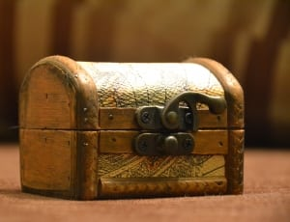
Chest of Hope
Area 16 District 17 Grass-roots effort
Goal: Provide LaVina Magazine Subscription certificates to Alcoholic Spanish-speaking inmates/groups in Correctional facilities in all 93 Areas across the US and Canada.
322 certificates were generously donated to the Chest of Hope.
Allowed the committee to provide each of the 93 Area Delegates in the US and Canada, LaViña magazine certificates.
Notes:
Started with the Committee on the Spanish International Convention held in Atlanta

Slide 25


VI. Literature
The updated draft video “Your General Service Office, the Grapevine, and the General Service Structure” be approved. PASSED
The “A.A.W.S. Policy on Publication of Literature: Updating Pamphlets and Other A.A. Materials”, approved by A.A.W.S., Inc. Board of Directors in Jan. 2020, be acknowledged and accepted by the GSC. PASSED

Slide 26
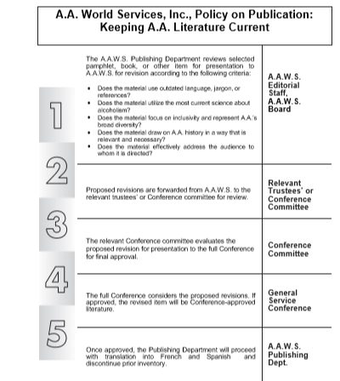
A.A.W.S. Policy on Keeping Literature Current
Notes:
Here is a chart that shows the process for updating literature. Note that ALL revisions will go to the full Conference for approval.
The complete explanation is included in the background materials on Literature posted on aageorgia.org
The purpose is to streamline the process of updating literature.

Slide 27

VI. Literature
Committee Considerations
Report back to 71st GSC for the following pamphlets:
  “Twelve Traditions Illustrated”, “Twelve Concepts Illustrated”, “AAs’ Three Legacies”, “Too Young”, “Young People in AA”, and the pamphlet for Spanish Speaking Women.
Request the committee explore plain language, accessible translations, and large print versions of Alcoholics Anonymous as well as workbooks to determine if these can be addressed with a common solution.

Slide 28

VI. Literature
Committee Considerations
Request a review of draft language to be included in Living Sober and the pamphlet “ Questions and Answers on Sponsorship”.
The final draft update of “Twelve Traditions
  Illustrated” is a distinct item from the original pamphlet, addresses a different audience, and serves a different purpose. Consider the addition of the new pamphlet rather than a replacement of the original.

Slide 29

VI. Literature
Committee Consideration: The committee recommended that the trustees make available the presentation “The Big Book: Researching Issues, Possible Tools and Access (7oth GSC 2020) that was presented to the committee. The committee noted the importance for the Fellowship to be informed about the nature of the accessibility challenges with regard to A.A. Literature. A progress report be brought back to the 2021 Conference Committee on Literature.

Slide 30

VI. Literature: Forwarded to the 71st GSC
The pamphlet “A.A. for the Black and African-American Alcoholic” be updated to include fresh stories and a new title that is respectful and inclusive. (Committee Recommendation-no vote)
Review proposed “A.A.W.S. Policy on Conversion of Written Conference-approved Literature and Service Material into Video Format”.
Consider requests to revise the book (4th Edition) Alcoholics Anonymous.
Notes:
As many groups read from the text, “Alcoholics Anonymous,” it would be helpful to include “p. 3- 41 of The A.A. Group” pamphlet its appendix. It is believed that having the pamphlet inserted would encourage best practices and participation in general service. Ultimately, this could help improve our service culture to the benefit of the groups, the still suffering alcoholic, and Alcoholics Anonymous as a whole.
We recommend that the Conference form a study committee to audit the first 164 pages of the Big Book with the purpose of identifying changes that can be made to make the Big Book more reflective of the A.A. membership composition. The focus should be on identifying the following for possible change:
• Pronoun usage – where possible the gender-neutral form should be incorporated.
• Passages or sections that are no longer consistent with or relevant when taken in context of society in general or the A.A. membership composition.
• The chapters To Wives and The Family Afterward should specifically be evaluated for revisions to be more consistent with today’s membership.

Slide 31

VI. Literature: Forwarded to the 71st GSC
Consider proposals related to a Fifth Edition of the book Alcoholics Anonymous.
Consider development of a draft Fourth Edition of the book Alcohólicos Anónimos.
Consider requests to revise the book Twelve Steps and Twelve Traditions.
Consider revisions to language and text in the pamphlets: “The A.A. Group”, “Frequently Asked Questions about A.A.”, “Questions and Answers on Sponsorship”, and “G.S.R. Your Group’s Link to A.A. as a Whole.”
Notes:
The committee reviewed requests for proposed Conference agenda items related to the possible development of a Fifth Edition of the book, Alcoholics Anonymous. The committee recognized the priority of addressing whether or not a Fifth Edition of the book, Alcoholics Anonymous, might be developed before addressing items related to content and format changes.
Suggested revisions include: Updated stories and revisions to Appendices III and V
12 x 12- remove opposite sex form para 2 p 117 in the Chp Step 12
Reconsider the phrase “lustful enough to rape” para 1 page 66 Step 6

Slide 32

VI. Literature: Floor Action
The pamphlet “A.A. for the Black and African-American Alcoholic” be updated to include fresh stories and a new title that is respectful and inclusive. ( Also an Agenda item that was forwarded.)
Motion to decline failed.

Slide 33

VII. Policy and Admissions
The “Process for Approving Observers to the Conference” be approved. PASSED
The General Service Conference implement electronic voting for trustee elections starting in 2021. PASSED
The review of Conference dates be changed to consider dates for the GSC with time and year(s) to review as requested by the General Manager.
PASSED
Notes:
Contracts for GSC are two-years
The current policy reviews the dates to be held two years hence-GSO mgmt. feels it would be more effective to have the committee review future conference dates biannually in two year chunks For example- in 2021 review dates for 2025 and 2026 which would allow venue research to begin by the end of 2021 and 2022

Slide 34

VII. Policy and Admissions
Committee Considerations
Consider a proposed process for the equitable distribution of Conference committees’ workload and noted the significant progress made by the trustees’ GSC Committee.
  Proposed process would help ensure equitable distribution
  Proposed Agenda Submission form would provide structure and clarity
Request that the trustees’ GSC Committee clarify specifics and bring a more fully developed process to the 71st GSC.
The Committee looks forward to a more detailed plan in 2021.
Notes:
Specific clarity as to how the process will impact what will happen regarding agenda items considered at the Fall and Winter trustees’ committee meetings
Clarity on how the process will impact or change the delegate chair’s participation in the Winter Board Weekend and on the Conference Committee’s January conference call to provide feedback on proposed agenda items-don’t want to take any backward steps in involving the delegates
Creating additional primary committees as needed-develop a sample composition, scope and procedures document for additional primary committees
Provide examples, using sample agenda items, on how the entire process would work

Slide 35
VII. Policy and Admissions: Forwarded to 71st GSC
Review G.S.O general manager’s report regarding GSC site selection.
Consider a proposed process for how a Conference committee could review, discuss, and act on proposed agenda items not forwarded to a Conference Committee.
Review the floor action process.

Slide 36

VII. Policy and Admissions: Floor Actions
Due to many agenda items being forwarded to the 71st General Service Conference, the 71st GSC Committee on Trustees consider the extension of the 71st GSC by as many as three working days and that consideration be offered regardless of whether the 71st GSC is held face-to-face or digitally.
Motion to decline PASSED
(The floor action will go no further.)

Slide 37

VIII. Public Information
A.A.W.S. video titles be adjusted for search engine optimization. (SEO) PASSED

Slide 38

VIII. Public Information
Committee Considerations
Reports Reviewed and Accepted:
  Regarding aa.org and aagrapevine.org
  Regarding Meeting Guide app
  Regarding Google AdWords/ Grants
  Regarding PI Comprehensive Media Plan
  Creating a plan to create video shorts on pamphlets
  Regarding relevance and usefulness of video PSAs
  A.A. Membership Survey
  Report back in 2021

Slide 39

VIII. Public Information
Committee Considerations
Reviewed and accepted the distribution and tracking information for the PSA “Changes”-updated PSA title changed to “Sobriety in A.A.: We made changes to stop drinking” (SEO)
Reviewed and accepted the report on the development of two new PSAs. Expressed, in light of the recent Covid19 pandemic, it would be helpful to include information on many formats for alcoholics to find and carry the message.
Notes:
Comprehensive media plan should prioritize social media, video/audio content and accessibility to the AA message

Slide 40

VIII. Public Information
Committee Considerations
Creating a new form of communication regarding anonymity and social media; requested information be gathered from the members before moving forward. Bring report or draft to 2021 GSC.
Request to develop a plan to create an A.A. podcast and bring back draft plan to the 2021 GSC.
Notes:
Shared experience from the Fellowship on how AA members adhere to anonymity traditions on various social media
Suggested safety and etiquette when using social media
Anonymity on video meeting platforms
Current available content (AA Guidelines on the Internet and Understanding Anonymity ) is dated and does not accurately reflect current technology or the Fellowship’s experience. Explore use of a video service piece.

Slide 41

VIII. Public Information
Committee Considerations
Shared concern on relevancy of print copy workbook and kit for PI and suggested exploring a service app, PDF versions, broader sharing, more accessibility information, and digital resources. Bring progress report back to 2021 GSC.
Encouraged by findings from survey professional on updating A.A. Membership Survey; noted the possibility of a digital questionnaire feedback form to be part of the discussions.
No items forwarded

Slide 42
VIII. Public Information: Floor Actions
The General Service Conference Consider developing a PSA about Alcoholics Anonymous geared towards minorities.
Motion to decline failed.

Slide 43

IX. Report and Charter
Recommended to Amend Article 4 of the current Conference Charter to read FROM: “…¾ vote of all conference members…” TO: “…¾ vote of all conference members participating in the vote…” PASSED
Notes:
This is in regard to reorganization of the GSB and the directors and staff of its corporate services when reorganization is deemed essential.

Slide 44

IX. Report and Charter
Committee Considerations
Reviewed and accepted : Report from Publishing regarding timely and accurate preparation and publication of the 2020 GSC Final Report
Discussed restoring two paragraphs with footnote to Concept Eleven previously removed by 66th GSC. TOOK NO ACTION
Reviewed draft of A.A. Service Manual and noted progress toward goals from 2019 Conference committee, requested updated draft incorporating suggestions from the 2020 Conference committee be brought back to the 2021 GSC.
Notes:
Advisory Action from 66th GSC The committee agreed that the footnote noting the 2 paragraphs are available upon request from GSO Archives is adequate

Slide 45

IX. Report and Charter:
Forwarded to 71st GSC
Discuss General Service Conference Final Report.
Discuss A.A. Directories (Canada, Eastern U.S., and Western U.S.).

Slide 46

X. Treatment and Accessibilities
The pamphlet, “Bridging the Gap” be updated for currency and inclusion to reach a broader scope of treatment settings about temporary contact services. A progress report or draft be brought back to the 2021 Conference Committee on Treatment and Accessibilities. PASSED

Slide 47

X. Treatment and Accessibilities
Committee Considerations
Suggested that the trustees’ CPC/TA committee develop a Bridging the Gap workbook and bring a progress report back to the 2021 GSC.
Reviewed progress report on updating the pamphlet “A.A. for the Older Alcoholic” and noted that
the current submitted stories did not
indicate a broad and diverse
representation of A.A. experience.
Suggested a reopened call for stories.
Reviewed both Kits and Workbooks and
forwarded a list of suggestions to the trustees’
C.P.C./Treatment and Accessibilities Committee
NO ITEMS FORWARDED
Notes:
Bridging the Gap workbook is a service piece and should include a list of temporary contacts available from GSO
Suggestions for stories_ Ethnic cultural and LGBTQ communities
Lifestyle diversity
Got sober later in life
Vets from Vietnam or later
Accessibility issues
Online and telephone AA meetings
Dementia or Alzheimer’s mental health concerns
Variety of spiritual pathways

Slide 48

XI. Trustees
The approval of the slate of trustees and officers for the General Service Board PASSED
The approval of the slate of directors for A.A.W.S., Inc. NO VOTE-Ruled Out of Order
The approval of the slate of directors for A.A. Grapevine Board, Inc. as presented PASSED
Notes:
The approval of the slate for next year's A.A.W.S. board- At the annual meeting of the GSB earlier today, a motion was made and seconded to remove the name of the newly selected NTD and approve the slate with a vacancy.
The motion was made to focus on the importance of unity, in our boards and with the fellowship. The amendment to the slate and the approval of the slate with a vacancy passed with substantial unanimity. That doesn't mean that the A.A.W.S. board will have to work short one board member as there is a process which allows the A.A.W.S. board to fill a vacancy in their bylaws Article III Section 8, page S129 of the Service Manual). It just won't be with a new NTD this year.

Slide 49

XI. Trustees
Committee Considerations
Reviewed the resumes and approved as eligible for election all Class B trustee candidates for West Central and Western Canada Regional trustee.
Elected by their regions:
  Mike Lewis West Central Regional Trustee
  Irma Van der Bon-Nicol Western Canada Regional Trustee
This Photo by Unknown Author is licensed under CC BY-SA-NC

Slide 50

XI. Trustees
Committee Considerations The 2020 Conference Committee on Trustees reviewed the slate of directors of A.A.W.S., Inc. and A.A. Grapevine, Inc.
Consider amending the Bylaws of A.A.W.S., Inc. Article III Directors to include language similar to that contained in the Bylaws of the General Service Board of A.A., Inc. regarding proposed new member trustees.
Consider clarifying procedure No 1 Grapevine and A.A.W.S. Boards Procedures for Nominating Corporate Board Directors, specifically for point 4 “Past Delegate –not eligible until one year after rotation,” to mean not eligible to apply or serve until 1 year after rotation.
The committee requests that a report be brought back to the 2021 Conference Committee on Trustees.

Slide 51
XI. Trustees: Forwarded to 71st GSC
Consider the revised “Procedures for a Partial or Complete Reorganization of the General Service Board, the A.A.W.S. or A.A. Grapevine Boards.”
The Conference Committee on Trustees agreed to include a memo for the 71st GSC proposing consideration of alternate trustees.

Slide 52
XI. Trustees: Floor Action
The 70th General Service Conference approve the slate of Directors for A.A.W.S., as originally submitted.
Motion to decline failed.
The slate of Directors of A.A.W.S., Inc. as submitted by the Conference Committee on Trustees, be approved.
Motion to decline failed.
Notes:
These floor actions are moot as they are forwarded to the 71st GSC and the is 70th now closed.

Slide 53

XII. Archives
No Advisory Actions
Committee Considerations
The committee considered requests to develop a book on A.A. history from 1955 through the present and suggested the trustees’ Archives Committee consider possible themes, content ideas, and time period such a book would cover. The committee requested a report be brought back to the 2021 Conference Committee on Archives.
Forwarded item: Review Archives Workbook.

Slide 54

XIII. International Conventions/Regional Forums
No Advisory Actions
Committee Recommendations
Accepted report from Talley Management outlining steps taken prior and post cancellation of the 2020 International Convention.
Discussed use of Lord’s Prayer for closing “Big Meetings” at the IC. After broad discussion, the committee concluded that further discussion is needed and that the 2021 Conference Committee on International Conventions/Regional Forums continue discussion at the 71st GSC.
Outlined a variety of ways to encourage interest in Regional and Local Forums.
No items forwarded
Notes:
Remote attendance
Digital Access to materials and presentations
Develop service materials for host committees
Local- early and frequent communication , involve members at all levels of service, sponsorship road trips

Slide 55

The 71st General Service Conference
A.A. in a Time of Change
Brooklyn, NY
April 20-24, 2021

Slide 56

Questions? Contact me
Debi Keane
Area 16 Delegate
Chair Conference Committee on Corrections
delegate@aageorgia.org
770-668-4685

Slide 57


