Slide 1

AREA 16 Secretary Workshop
BY:
Todd B.
770-364-7765 cell
secretary@aageorgia.org

Slide 2
Secretary Workshop
Agenda
  Introduce new secretaries to the role and provide supporting resources
    Group, Zone, Intergroup, or District
  Secretary Role
    See GA Service Manual and AA Service Manual
      Pamphlets: The AA Group, Twelve Traditions

Slide 3
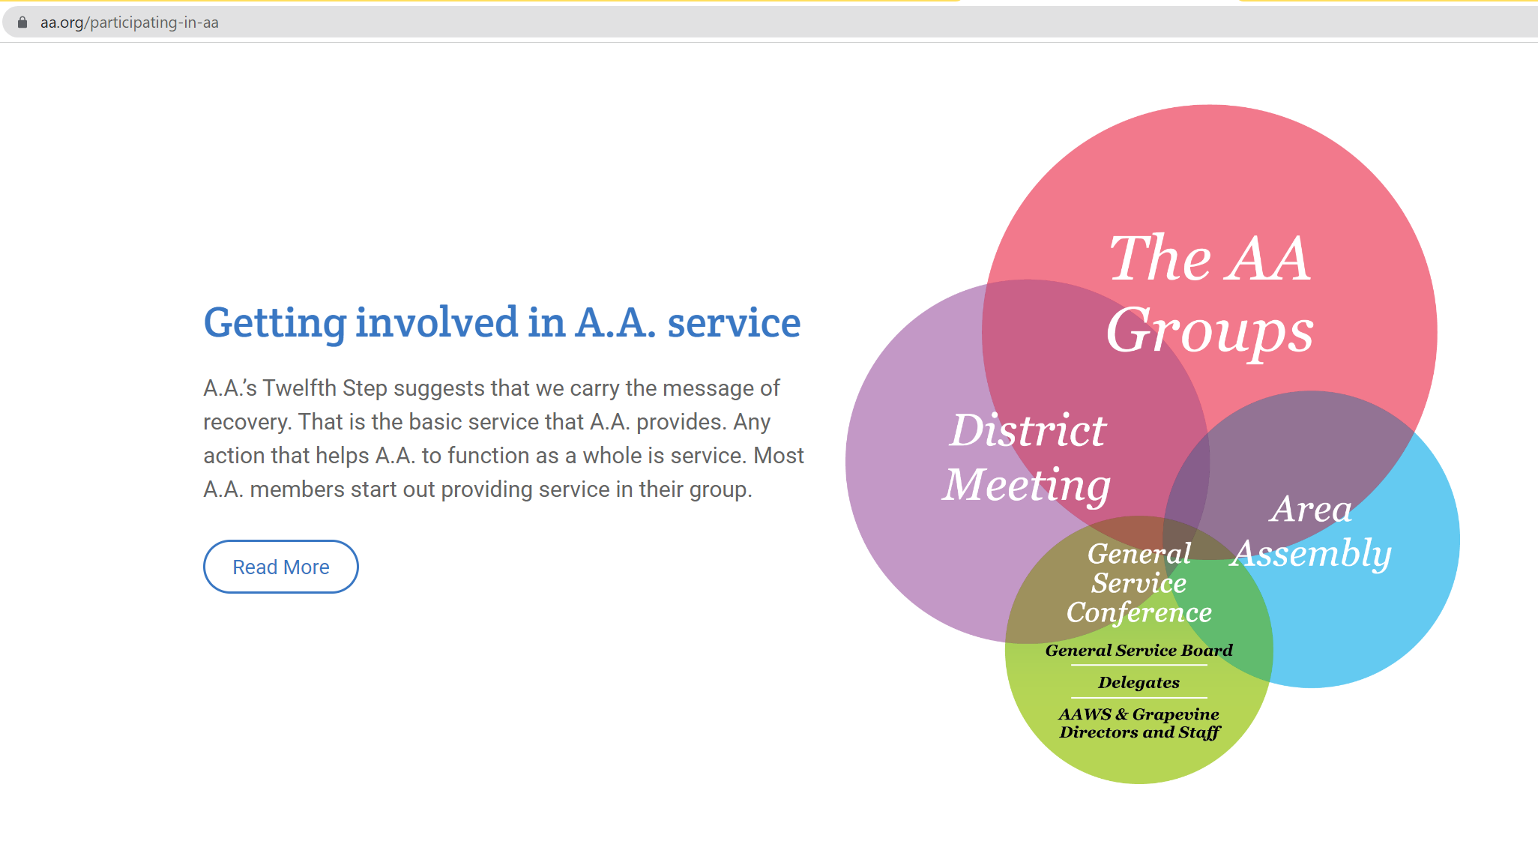
Getting Involved

Slide 4
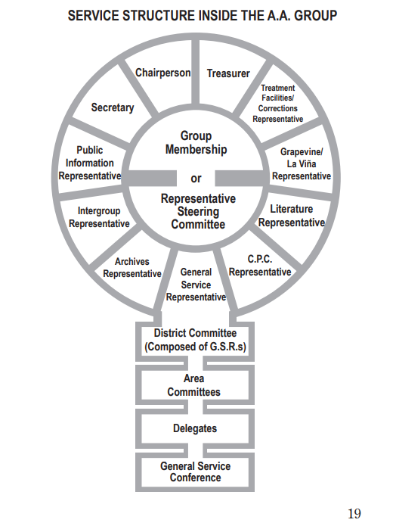
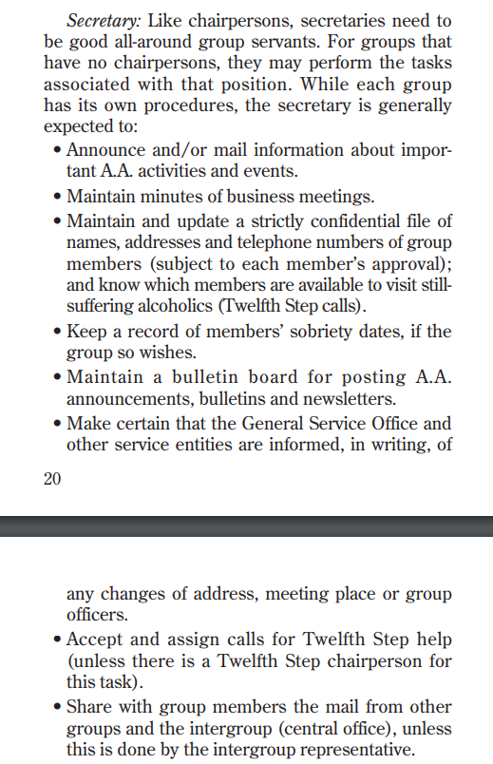
Secretary Duties (AA Group)

Slide 5
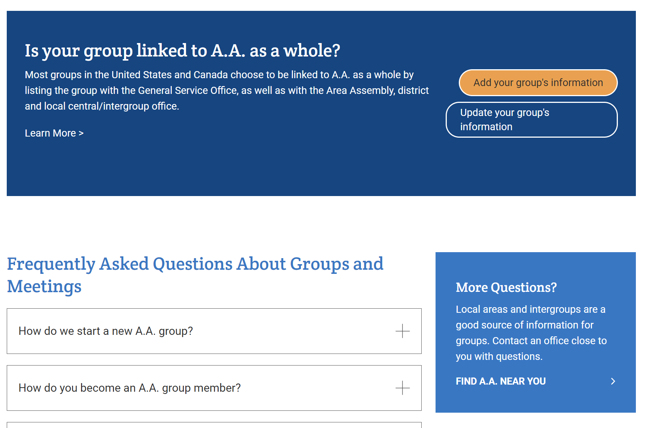
Communication and Connections

Slide 6
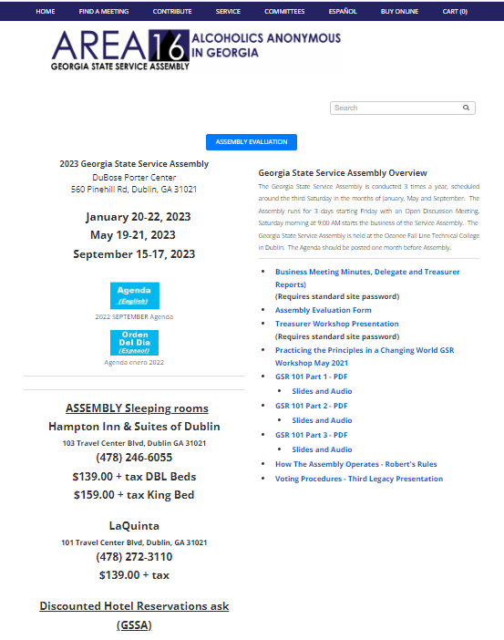
Area 16: www.AAGeorgia.org

Slide 7
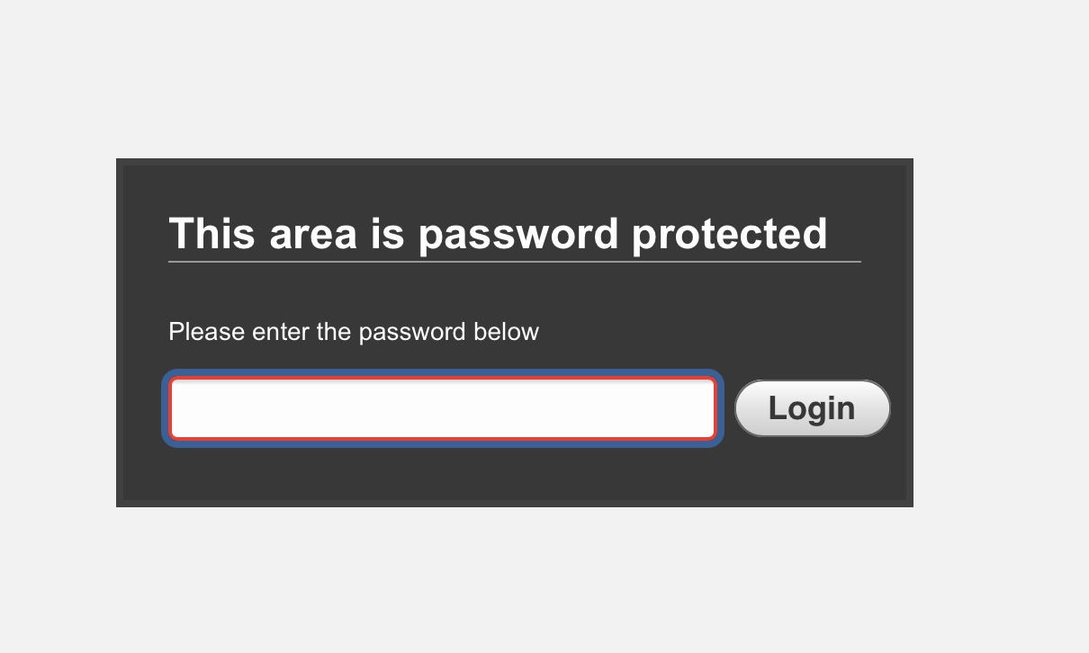
www.AAGeorgia.org
Password: Gssa@2006

Slide 8
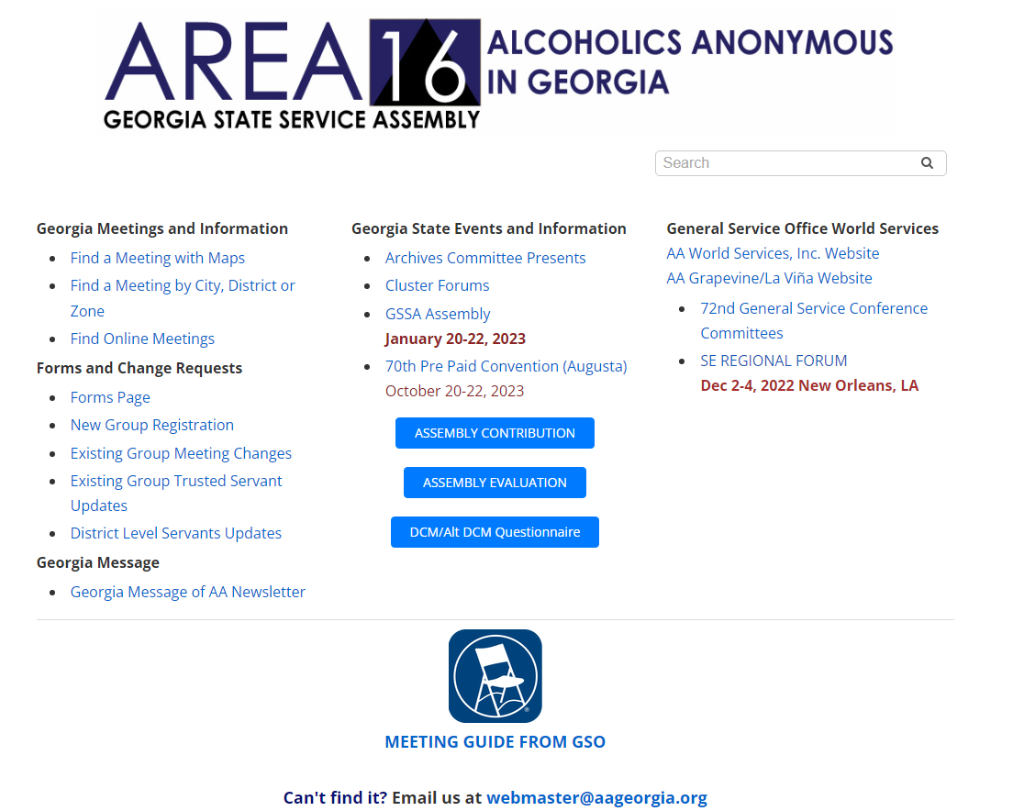
Group Updates Page
New Groups
Group Changes
Trusted Servant Updates
District Updates

Slide 9
Service Directory Updates
https://www.aageorgia.org/georgia-service-directory-contacts.html
DCM’s, GSR’s, Secretaries, and Treasurers please discuss at District Meetings and focus on accuracy. A traveling AA may depend upon this information
  Are Trusted Servants updated every rotation?
Group updates with Tamera for Districts that do not have any Intergroup Office or Central Office
Group Updates to Central Office in those Districts with Intergroup

Slide 10
Are we working together?
Secretary role is a key role if done well
  Focus on Communication
  Keep group minutes updated at District
  Do minutes include a Treasurer Report?
  Support Group and Zone
  Update information for Group and Zone regularly at meetings?

Slide 11
In Closing
Thank you for all your service
Next Steps:
  Make Connections
  Get Involved
  “Come with us” attitude
      GSR, Secretary, Treasurer, and Groups get informed, stay connected, update Group Information
I am here to listen and serve
  Email, text, call
    Todd B.
    770-364-7765 cell
    Secretary@aageorgia.org

