Slide 1
Welcome!
DCM 101
Debi K., Area 16 Chairperson

Slide 2
What we’ll try to cover today
Discussion/Sharing on Chapters 1-3

Slide 3
DCM 101

Slide 4
Chapter 1 Discussion Topics
Leadership in A.A.: Ever a Vital Need
A.A.’s Legacy of Service by Bill W.
A.A.’s Single Purpose
A.A.’s Principles of Service
A.A. Groups – The Final Voice of the Fellowship
Informed Group Conscience
The Home Group

Slide 5
Introductions
A little about yourself:
Sobriety date?
District/Zone
How long in Area Service?
How long as DCM?
Most impressionable (short) service story?
Notes:
Let’s introduce ourselves

Slide 6
Agenda
Chapter 3 – The GSR
The GSR
GSR at District
During the District Meeting
GSR at their next Home Group Business meeting
"All about those AA Group Problems"
AA Literature
Suggestions for GSR at Area 16 Assembly
Registering as a new GSR or Alternate
Notes:
The most important Job – The Communication to/from the groups

Slide 7
Leadership in A.A. : Ever a Vital Need
No leader is “faceless”
No Leader Perfect
Dedication
Stability
Vision
Special skills
Lead by Example
Originates Plans, Policies, and Ideas
Never “passes the Buck”
Notes:
Bill’s - From Concept IX
Just a few leadership qualities/skills

Slide 8
Leadership in A.A. : Ever a Vital Need
“We shall be in continual need of these same attributes – tolerance, responsibility, flexibility, and vision – among our leaders of A.A. service at all levels. The principles of leadership will be the same whatever the size of the operation.”
Bill W.
“We thank God that Alcoholics Anonymous is blessed with so much leadership in all its affairs.”
Notes:
Last line of “Leadership” Article
Doesn’t matter what/where in A.A. Service – Homegroup to General Service Conference/GSO/Trusteee levels.

Slide 9
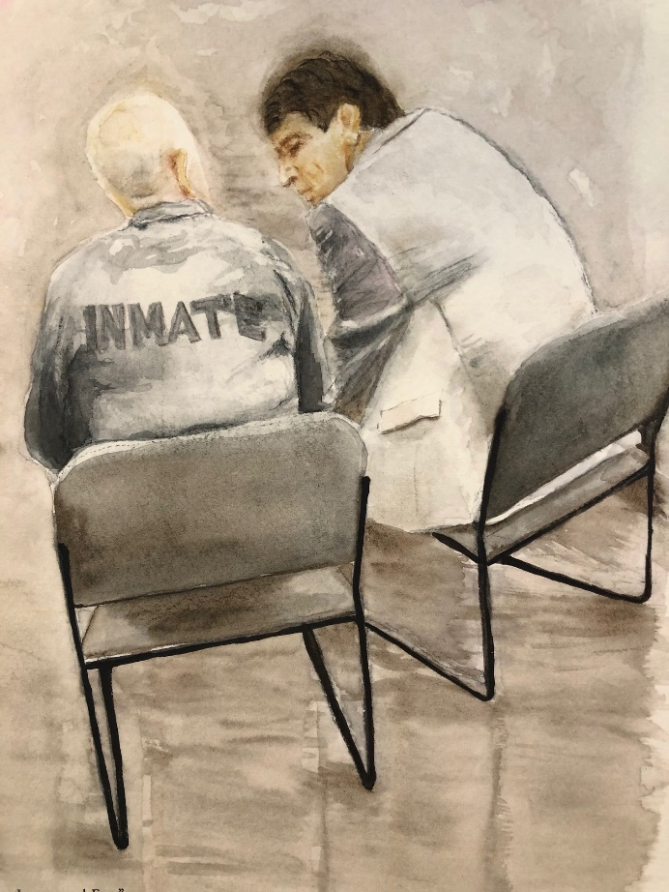
A.A.’s Single Purpose
Tradition Five: Each Alcoholics Anonymous group ought to be a spiritual entity having but one primary purpose—that of carrying its message to the alcoholic who still suffers.
Notes:
Tradition 5 – In the heat of meetings, we can sometimes forget “why we’re doing all this service work”. We need to constantly remind ourselves. This picture is a painting from the scene of Jim T. talking to a newcomer inmate. He is about to step on the stage at the International Convention and tell his story for the first time ever in front of over 55,000 A.A.s – No pressure! Still, one alcoholic sharing with another and carrying the message……………
You can ask Jim about the event!

Slide 10
A.A.’s Single Purpose
“Let us resist the proud assumption that since God has enabled us to do well in one area we are destined to be a channel of saving grace for everybody.”
A.A. Co-founder Bill W. 1955
Notes:
We can’t be all things to everybody – stick to what we do best………

Slide 11
A.A.’s Principles of Service
… One Primary Purpose
….Fully Self-supporting
….Remain forever non-professional
….Never be organized
….Leaders but “Trusted Servants”
…..Try to carry this message to Alcoholics, practice these principles in all affairs
Finally incorporated into our traditions
Notes:
From A.A. Comes of Age – Finally incorporated into our Traditions

Slide 12
A.A. Groups – The Final Voice of the Fellowship
Notes:
Where’s that come from?? Concept 1. “the ultimate responsibility and final authority for World Services resides with the groups— rather than with the trustees, the General Service Board or the General Service Office in New York”.
I like: If you want better trustees, we need better delegates. If we want better delegates, we need better committee members. If we want better DCMs, we need better GSRs. Better service suggests better unity. Better unity suggests better recovery.
The entire structure of A.A. depends upon the participation and conscience of the individual groups, and how each of these groups conducts its affairs has a ripple effect on A.A. everywhere. You help with this!!

Slide 13
A.A. Groups – The Final Voice of the Fellowship
Each group is as unique as a thumbprint, and approaches to carrying the message of sobriety vary not just from group to group but from region to region. Acting autonomously, each group charts its own course. The better informed the members, the stronger and more cohesive the group — and the greater the assurance that when a newcomer reaches out for help, the hand of A.A. always will be there.
A.A. Group Pamphlet - pg. 11
Notes:
Here’s where your guidance comes in……………….

Slide 14
Informed Group Conscience
Notes:
What’s it mean??

Slide 15
Informed Group Conscience
Central to A.A. and the Service Structure
Guiding Spiritual Principle at all levels of A.A.
Group Meetings
District
Area Assemblies
General Service Conference
Unites in a common purpose………
“to stay sober and extend the hand of A.A. to the alcoholic who still suffers.” Box 459 – Vol.35, 1989
Notes:
Key to all we do in service; no “quick decisions”. Rises above the individual

Slide 16
The Home Group
Notes:
I like the guy with the saw’s face! Any body know this character???

Slide 17
The Home Group
Notes:
We will talk a lot about this very important resource; it is perhaps one of the most important pamphlets for and referenced by Groups.

Slide 18
The Home Group
For most A.A.s, membership in a home group is one of the keys to continuing sobriety.
The home group affords individual A.A.s the privilege of voting on issues that affect the Fellowship as a whole; it is the very basis of the service structure.
As with all group conscience matters, each member has one vote.
“from coffee maker to secretary, treasurer, or chairperson is usually the way members first experience the joy and the growth that can be derived from A.A. service.” The A.A. Group Pamphlet

Slide 19
What we covered………….
Leadership in A.A.: Ever a Vital Need
A.A.’s Legacy of Service by Bill W.
A.A.’s Single Purpose
A.A.’s Principles of Service
A.A. Groups – The Final Voice of the Fellowship
Informed Group Conscience
The Home Group

Slide 20
Discussion/Sharing

Slide 21
The District & D.C.M

Slide 22
Chapter 2 Discussion Topics
District
D.C.M.
Alternate D.C.M
DCM Email
Area 16 Web
Area Directory
District Meeting Minutes
District Officers
District Service Chairs
How Assembly Operates

Slide 23
What is a District?
“a geographical unit containing the right number of groups — right in terms of the committee member’s ability to keep in frequent touch with them, to learn their problems, and to find ways to contribute to their growth and well-being.”
Linguistic (Our District 17) – “are made up of groups that conduct meetings in a language other than English. They usually have a bilingual D.C.M. or liaison. Their boundaries may be independent of the conventional geographic district boundaries. “
Notes:
I had 42 groups at one point at the end of my term as DCM; this sounds like a DCM job description also…….

Slide 24
D.C.M.?
“an essential link between the group G.S.R. and the area delegate to the General Service Conference.”
“As leader of the district committee, made up of all G.S.R.s in the district, the D.C.M. is exposed to the group conscience of that district.”
“…able to pass on the district’s thinking to the delegate and Area committee”.
“The G.S.R.s elect a district committee member (D.C.M.).”
“D.C.M.s are usually elected before the area assembly meeting at which the delegate is elected. Some areas, however, rotate half their committee members each year. “

Slide 25
D.C.M. Qualifications? -A.A. Service Literature-
“The qualifications for a good district committee member are not complicated: background in A.A. service work that goes with the G.S.R. job, and perhaps some central office/ intergroup service..”
“A D.C.M. should have enough sobriety (generally four or five years) to be eligible for election as delegate.”
“He or she also needs to have the time and energy to serve the district well.”
Notes:
Anybody add anything???

Slide 26
D.C.M. Qualifications? -Area 16 Service Manual-
Four (4) to five (5) years of continuous sobriety within the State of Georgia (so that he/she may be eligible for election as Delegate).
Experienced in group affairs, such as secretary, Central Office, etc.
Should be able to coordinate and lead.
Have served a minimum of one (1) year as G.S.R. engaged in group, district and State Assembly affairs.
Time and energy to serve his/her district as well as liaison between Delegate and district.
Be well prepared to place principles before personalities
Notes:
These are your Area 16 Qualifications

Slide 27
What are the Duties?? -A.A. Service Literature-
Regularly attends all district meetings and area assemblies.
Receives reports from the groups through G.S.R.s and through frequent personal contacts with groups in the district.
Holds regular meetings of all G.S.R.s in the district.
Helps the Conference delegate cover the area, which would be impossible for the delegate to do on a group-by-group basis.
Assists the delegate in obtaining group information in time to meet the deadline for A.A. directories.
Keeps G.S.R.s informed about Conference activities; this includes setting up opportunities for the delegate’s Conference report, occasionally making the Conference report if the delegate cannot be present, and inviting the delegate to regular district meetings.

Slide 28
What are the Duties?? -A.A. Service Literature- (Cont’d)
Makes sure that G.S.R.s are acquainted with The A.A. Service Manual, the Twelve Concepts for World Service, the G.S.O. bulletin Box 4-5-9, workbooks and guidelines from G.S.O., and any other service material.
Helps G.S.R.s make interesting reports to groups and encourages them to bring new A.A. members to service events.
Keeps groups informed about Conference-approved books and pamphlets.
Organizes workshops and/or sharing sessions on service activities.
Regularly keeps in touch with the alternate D.C.M. and the delegate; sends district minutes to the delegate and alternate, and exchanges them with other districts.
Brings Traditions problems to the attention of the delegate.
Makes a regular practice of talking to groups (new and old) on the responsibilities of general service work.
In addition, the DCM schedules district meetings, chairs the meeting, and sets the agenda in accordance with the conscience of the district.
Notes:
This what you’d receive most times from the Delegate or Office Committee via Email

Slide 29
Duties from GA Service Manual
Attend and chair regular district meetings.
Maintain current roster of G.S.R.s in district and make sure each group has a G.S.R.
Receive and consider G.S.R. reports.
Discuss group and district affairs with G.S.R.s and encourage group participation of G.S.R.
Be available to assist and guide G.S.R.in district.
Maintain handbook, follow procedures, get D.C.M. work done.
Prepare brief, factual, written report; send legible copy to Georgia State Assembly Office.
Bring any district problems and/or activities to Assembly which may benefit others.
Have good grasp of group conscience of the district.
Make sure G.S.R.s understand and are familiar with the Service Manual and G.S.R. handbook.
Encourage G.S.R.s to attend training sessions, workshops, sharing sessions, etc.
Through G.S.R.s, encourage groups to reach out into community through open meetings, institutions, radio, TV, etc.

Slide 30
Sharing from D.C.M.s to a New D.C.M
“I was taught that, as in any other endeavor, the success of a D.C.M. depends on the leadership of the person occupying the position. If a D.C.M. loses interest, it will trickle down to the rest of the district, but strong D.C.M.s create strong and active districts.”
“Feel free to invite area committee chairs and officers to attend as many of the district and group service events as they want – from district meetings to workshops and sharing sessions. You would be amazed at the amount of interest and enthusiasm this can generate in the district.”

Slide 31
Sharing from D.C.M.s to a New D.C.M (Cont’d)
“As the incoming D.C.M., I received the district’s group list from our area registrar. It used to be that at our district meetings we were lucky if we had 50 percent attendance. My service sponsor suggested that I visit each group to introduce myself to the group G.S.R. and invite them to the next district meeting – this must have had an effect because now we are up to 90 percent participation! Now I send gentle reminders by email to remind the G.S.R.s about the district meeting and to see if they need anything placed on the agenda. I call those who do not have email.”
Notes:
Try this!!

Slide 32
“Silent” Groups
Reach Out – Don’t wait for them to show up
Introduce yourself
Ask if they have a GSR
Ask if you can be invited to the next Group Conscience
Explain their “voice” is not heard at District, Area, and A.A. as a whole
Discuss the many Service Opportunities at District and your experience in Service
Invite them to the next District Meeting
Be Enthusiastic!
Notes:
More ideas??? Examples from my experience.

Slide 33
Growing Responsibilities for D.C.M.s
“Continuing growth of the Fellowship brings new opportunities for service to the D.C.M. As the numbers of groups in an area increase, the maintenance of a vital active link between the groups and the Fellowship as a whole becomes a challenge to the D.C.M.s. By maintaining active contact, both with the groups in the district and with the area delegate, the D.C.M. is a key link in ensuring that all the A.A. groups are aware of the importance of their total participation in local, district, area and world services.”

Slide 34
How to Conduct a “Sharing Session”
“The purpose of a Sharing Session is to fill a need for improved communication among Area committee, Districts, and Groups, thereby strengthening services in A.A. through cooperation. “
“Sharing Sessions are not designed to reach a conclusion as, say, at a regular A.A. business meeting. They are usually held where a problem has reached difficult proportions at the service level involved, and options to surmount the challenge need to be thought about.”

Slide 35
How to Conduct a “Sharing Session” (cont’d)
The usual Sharing Session format provides for a “chairperson” who presents the problem to be discussed, and then asks for comments. Participants respond, usually going around the room, speaking for no longer than a specific time agreed upon ahead of time by everyone present (perhaps one or two minutes), after which a bell is rung to indicate “time up.” A participant may speak again on the same topic only after all others have shared once. He or she may then speak again, in turn. The sharing continues until all have said what they need to say on each go around the room. Remember, no one need ever be ashamed of his or her opinion.

Slide 36
How to Conduct a “Sharing Session” (cont’d)
“To be effective, Sharing Sessions should include no more than 30 participants (larger groups can be broken into two sessions). These sessions may also be built into regular Area, District or Group meetings. Area Committees may find that Sharing Sessions foster greater interest and willingness on the part of General Service Representatives (G.S.R.s) to participate. Districts and Groups may find Sharing Sessions a preferred way to discuss issues that are particularly sensitive or thorny.”

Slide 37
GSO Resources for D.C.M.s – D.C.M. Kit

Slide 38
GSO Resources for D.C.M.s – D.C.M. Kit (Cont’d)

Slide 39
Alternate D.C.M.
The alternate is a backup for the D.C.M. If the D.C.M. resigns or is unable to serve for any reason, the alternate steps in. Usually, the alternate is elected at the same time as the D.C.M., by the same procedure. Alternate committee members should be encouraged to assist, participate, and share in the D.C.M.’s responsibilities at district and area meetings.
Notes:
Give your alternate “Real Work” to perform! Don’t take it on yourself. Let them run a meeting.

Slide 40
Area 16 Email
As stated previously, communication between the DCM, Groups, and Area is of utmost importance. In order to receive and transmit communications efficiently, an Area 16 email account is provided to each DCM. It is very important to monitor your email account regularly.
As a general rule, DCMs are encouraged to share login and password information with their alternate DCM. This allows for timely two-way communications. The DCM and alternate should work out amongst themselves how and when to respond to emails they receive, need to read, and who will follow-up on.
Notes:
How many of you have this on your smartphone??

Slide 41
Area 16 Website
Area 16 maintains a website at aageorgia.org through the efforts of the Web and Communications Committees.
The website provides Area 16 with information pertaining to A.A. services, meetings, Area 16 programs, committee pages, links to the GSO website, and additional reference information.
The following is a brief description of the main website drop-down menus and associated sites:
Notes:
A New Design is underway soon……..

Slide 42
Area Directory
The Area Service directory is a great resource for you and is available in print-form and online at aageorgia.org.
It contains all the contact information you need for the Office Committee, Delegate, Committee Chairs/Co-chairs, other DCMs, Groups, and GSRs.
The online directory is updated periodically to include new and updated information. So, if you review your printed version and cannot locate a resource, go to the online version for the most up-to-date information.
Notes:
Contact The GSSA Office for Information

Slide 43
Area Directory (Cont’d)
The Directory is password protected because it contains full names, addresses, and telephone numbers of A.A. members in Area 16 service.
Please do not disclose any information from this directory without the expressed permission from the individual(s) listed in it.

Slide 44
Area Directory Directory

Slide 45
District Meeting Minutes
District meeting minutes are an important means of communication to your district GSRs, Committee Chairs, District officers, and members-at-large.
In addition, the minutes help your Delegate and Office Committee understand the topics that are important to your district.
Please be sure your District Secretary sends a copy of the District meeting minutes to districtminutes@aageorgia.org.
Notes:
I have caught Mis-information in these also and have called the DCM to inform them.

Slide 46
District Chairs and Officers
Districts usually consists of 4 Officers, 6 Committee Chairs, serving the GSRs. There is no hierarchy in AA, no order givers or order takers. The District supports the Groups they serve.
We ought to feel free to engage with AA at any level of the AA Service Structure, from the AA member down to every person working at our General Service Office.
Our objective is as always to better facilitate the AA message to the still suffering alcoholic.
Each Committee Chair ought to review AA literature; aa.org provides pamphlets, workbooks, and guidelines to assist in efforts to form and begin a practical agenda.

Slide 47
District Chairs and Officers Below are a few common suggestions for new Committee Chairs;
Discover the Group/Area 16/GSO Chair’s contact information. Communication is key, if a Group does not have a particular Chair, contacting the GSR or using the GSR as a contact is helpful. If there is neither, then send reports by snail-mail or through the District Secretary monthly newsletter. Getting face to face with 'corresponding Chairs at the Groups/District/GSSA is exceptionally helpful. The District/Area/GSO has a website available with a list of contacts of Officers and Committee Chairs.

Slide 48
District Chairs and Officers (Cont’d)
Determine how often and where or how/when the Committee ought to meet. Creating and sharing the agenda and meeting information with the corresponding group rep., Group Chair, Area 16 Chair, and GSO Chair. Experience shows help from past Chairs who held committees, is the best source in determining an outline for goals and creating Committee meetings.

Slide 49
District Chairs and Officers (Cont’d)
Communicate and share meeting minutes & notes with Area 16, Delegate, GSO, and our District Groups by providing reports in writing.
This report and information about the Committee to aid 12th step work can be sent monthly to the District Secretary.
Share your experience with other Committee Chairs and the District as a whole, at the monthly District meeting.

Slide 50
District Chairs and Officers (Cont’d)
Cooperation with the Intergroup Committee Chair (if there is an Intergroup Chair) by sharing and inviting them to sit in on Committee meetings provides a different perspective and often opens up the many Intergroup resources.

Slide 51
CPC – Cooperation with Professional Community
Members of these committees provide information about A.A. to those who have contact with alcoholics through their profession. This group includes health care professionals, educators, members of the clergy, lawyers, social workers, union leaders, and industrial managers, government officials, as well as those working in the field of alcoholism. Information is provided about where we are, what we are, what we can do, and what we cannot do.
Notes:
Listed now in Alpabetical order by committee then, officers

Slide 52
Corrections
The purpose of a corrections committee is to coordinate the work of individual A.A. members and groups who are interested in carrying our message of recovery to alcoholics behind the walls, and to set up means of smoothing the way from the facility to the larger A.A. community through prerelease contacts.

Slide 53
Grapevine & La Viña Representative (GvR)
GVRs and RLVs act as advocates for Grapevine and La Viña at the group and district level, alerting their groups to the use of the magazines as recovery tools. It is, many say, the best service job they’ve ever had. Gv website is www. aagrapevine.org.
Originally GVRs focused on Grapevine, and RLVs on La Viña. But as awareness of the needs of Spanish-speaking AAs throughout the United States has grown, some reps have begun to work with both magazines and refer to themselves as GVR/RLVs.

Slide 54
PI- Public Information
Like all of A.A., the primary purpose of members involved with public information service is to carry the A.A. message to the alcoholic who still suffers. Working together, members of local Public Information committees convey A.A. information to the general public, including the media.

Slide 55
Treatment
Treatment Committees are formed to coordinate the work of individual A.A. members and groups who are interested in carrying our message of recovery to alcoholics in treatment and outpatient settings.

Slide 56
Bridge-the-Gap Committee
We have also set up a committee to “bridge the gap” from Corrections and Treatment facilities to A.A. groups in the communities of those getting out of such facilities.

Slide 57
Accessibilities
While there are no special A.A. members, many members have special needs. For the purpose of these Guidelines, we define A.A.s with special needs as persons who are blind or visually impaired; deaf or hard of hearing; chronically ill or homebound, those who are developmentally disabled, and many others who may have less visible challenges.
One A.A. member reminded us that, in carrying the message to the deaf alcoholic, “Try not to treat them as different or special but allow them freedom to participate in a typical A.A. meeting.”

Slide 58
Secretary
Records the minutes of each district meeting and distributes them to all groups and district trusted servants in a timely fashion. Maintains a confidential list of all district trusted servants, GSRs, Alternate GSRs, and groups within the district. District Secretary is the hub of communications of the District, working closely with all levels of Committee and Officers, managing reports and mailing reports to Groups.

Slide 59
Treasurer
As directed by the district, conducts all financial activities of the district. Chairs the budget committee and participates in the year-end process of preparing the next year’s budget to be presented for approval and voted on in December of each year. The Treasurer usually maintains a business banking account for the deposit and disbursement of district funds.

Slide 60
Robert’s Rules of order
How Alcoholics Anonymous Can Loosely Apply Them

Slide 61
What are Robert’s Rules
Originally written in 1876 by Army Officer Henry M. Robert
Adopted the rules and practices of Congress to non-legislative societies
Parliamentary law minus provisions that pertain to legislative bodies only
The rules that govern the conduct of legislatures and other deliberative bodies.
Provides guidance on a fair and orderly method for conducting a meeting.
The General Service Conference of Alcoholics Anonymous uses Robert’s Rules of Order to provide consistent, orderly meetings that support the rights of all concerned.
The larger the group and more complex the work, the more rules would be used.
Small groups can simplify the rules to provide structure without overdoing it.

Slide 62
The Purpose of Robert’s Rules
The purpose of Robert’s Rules is "to enable assemblies of any size,
with due regard for every member's opinion,
to arrive at the general will on the maximum number of questions of varying complexity
in a minimum amount of time and
under all kinds of internal climate ranging from total harmony to hardened or impassioned division of opinion”

Slide 63
Applying Robert’s Rules to AA in Georgia
In order of the most structure to least:
Georgia State Service Assembly
District/Zone meetings
Group business meeting/group conscience

Slide 64
General Rules of Discussion and Voting
People who wish to speak line up at the microphones and are called on in order.
Each person may speak for two (2) minutes.
No one may speak for a second time on a topic until all who wish to have spoken for the first time.
Full discussion of a recommendation should take place before each vote.
Everyone is entitled to (though only GSR’s vote), and should, express his or her opinion. However, if your perspective has already been stated by someone else, it is not necessary to go to the microphone and say it again.
Premature actions (e.g., amending motions early in the discussion or hastily calling the question) can divert attention from the subject at hand, thus confusing and/or delaying Assembly business.
Voting is by show of hands except for Officer Elections which are closed ballot.

Slide 65
HOW THE ASSEMBLY OPERATES
The purpose of rules of order is to make it easier for the Assembly to conduct business
All voting that concerns a manual change or an election will require a two-thirds majority
Only GSR’s or their designated alternate are eligible to vote and, make motions
Everyone is allowed to participate in discussion
People who wish to speak must raise hand and be called upon
Each person may speak for two minutes
No one may speak for a second time on a topic until all who wish to have spoken for the first time
Full discussion should take place before voting

Slide 66
HOW THE ASSEMBLY OPERATES
However, if your point has already been stated it is not necessary to state it again. (This will save time)
Premature actions such as amending motions early and/or calling the question may divert attention and prolong debate.

Slide 67
MOTION TO DECLINE TO CONSIDER
New Procedure added by majority vote at September 2021 Assembly
After a motion from the floor is made and seconded, the Chair shall ask the Assembly if there is a Motion to Decline to consider the original motion.
A Motion to Decline to consider the original motion must be made without comment, must be seconded, and is not debatable.
A Motion to Decline requires two-third majority vote to pass; there is no Minority Opinion.
If Motion to Decline passes by 2/3 majority, then the original motion is declined and the Assembly proceeds to the next business item.
If there is no Motion to Decline, the Motion to Decline fails, or there is no second, the original motion is then discussed on the Assembly floor.

Slide 68
AMENDING MOTIONS
Can be made to improve the idea or clarify the meaning of a motion
Made by striking words, adding words, or by striking and adding words
Requires a second and a majority vote to be adopted
If not, discussion of original motion continues

Slide 69
CALLING THE QUESTION
Brings discussion to a halt while the Assembly decides whether to proceed directly to a vote or continue with discussion
Must be made in order by raising hand and being called upon
Must be made without comment
Requires a second
Is not debatable
Requires a two-thirds majority

Slide 70
MINORITY OPINION
After each policy vote the side which did not prevail will be given an opportunity to speak their position
If the motion passes with two-thirds, the minority may speak
If the motion receives a majority, but not two-thirds, the majority may speak (in this case the majority is in fact the minority because their motion failed)
There is not an automatic re-vote after the minority speaks. Only a motion to reconsider can bring about a re-vote

Slide 71
Can only be made by a member voting on the prevailing side
Can be seconded by anyone
Requires a simple majority
If a majority votes to reconsider, full discussion, pro and con is resumed
No action may be reconsidered twice
RECONSIDERATION

Slide 72
TABLING A MOTION
Is postponing discussion to a later time
Must be made without comment
Requires a second
Is not debatable
Requires a simple majority

Slide 73
Georgia District/Zone Meetings
Application of Robert’s Rules in a Smaller Meeting

Slide 74
Meeting structure
A district/zone may have bylaws and traditions
Bylaws are basic rules or practices for an organization (of any kind/size)
traditions with a small “t” – how we have always done something
Meetings are usually monthly
DCM is typically the chairperson
Robert’s Rules can be used
Less formal than the Assembly
Some topics require group input and others do not

Slide 75
Applying the Rules
Study Committees – when there is a need to inform the group conscience
Substantial unanimity – 2/3rd majority, should use for bylaw or “t”radition changes
Simple majority may be used for minor issues not covered above
Using formal motions allow each member to be heard
Motion process
Motion made and seconded
Discussion until all comments have been heard
Ask for minority opinion from side that did not prevail
Allow for a reconsideration vote – requested by prevailing side following the minority opinion

Slide 76
Examples
District/zone is considering moving the location of meeting.
A motion is made and seconded, followed by the DCM appointing a Study Committee – Study Committee might be appointed without a motion
A report is made to district/zone of findings – locations available and costs
GSRs take it back to group to get group’s conscience and vote the following meeting
The motion process occurs as previously described
District/zone has to pick a topic for the upcoming Cluster Forum theme
DCM will ask the group for ideas or present a few options
After discussion, the DCM may ask for a motion to recommend a topic or a show of hands for the most popular topics.
This would not go back to the groups as the GSRs will present the topic at the Cluster Forum – there is not change in bylaws/traditions or finances

Slide 77
What rules would you use if….
District/zone treasurer recommends allowing groups to contribute online
Study committee
Motion process
Show of hands in support of treasurer setting it up
Substantial unanimity – 2/3rd majority
DCM wants to start the meeting with group updates instead of DCM report – this changes the format of the meeting
Study committee
Motion process
Show of hands in support of DCM changing the format
Substantial unanimity – 2/3rd majority

Slide 78
Other examples

Slide 79
Home Group business meeting
Group Conscience

Slide 80
Meeting structure
An AA group may have bylaws and traditions
Larger groups have more structure
Small groups may have no structure
All groups have traditions with a small “t” – how we have always done something
Business meetings/group conscience can be monthly, quarterly or as needed
The chairperson may be a service position or filled by a trusted servant such as GSR
Robert’s Rules can be used
Less formal than the Assembly
Group may want to ensure full participation when discussing important matters to the group

Slide 81
Applying the Rules
Study Committees – when there is a need to inform the group conscience
Substantial unanimity – 2/3rd majority, should use for bylaw or “t”radition changes
Simple majority may be used for minor issues not covered above
Using formal motions allow each member to be heard
Motion process
Motion made and seconded
Discussion until all comments have been heard
Ask for minority opinion from side that did not prevail
Allow for a reconsideration vote – requested by prevailing side following the minority opinion

Slide 82
Examples
A group member would like to change the type of cookies
Chairperson may ask for a motion and use the motion process
Or the chairperson may just ask for a show of hands in support of Chips Ahoy
This can be a simple majority and quickly resolved BUT some topics are sensitive
If cookies are a sensitive topic, the chairperson should use the motion process to make sure every member is heard and a substantial unanimity to ensure unity on the cookies
Group is considering adding a Big Book Study to an existing meeting night
A motion is made and seconded.
The chairperson allows for full discussion – hear all that want to share *good time to remind group that they don’t need to repeat an idea that has been shared ☺
The motion may be tabled to next meeting if there is not full representation of members or it wasn’t known that it was going to be discussed or if there are questions about space or other like meetings in the area, etc
If tabled, discussion resumes at next meeting and any additional information is shared
The motion process occurs as previously described

Slide 83
What rules would you use if….
Some members of the group would like to add a meeting night
Study committee
Motion process
Show of hands in support of adding another meeting
Substantial unanimity – 2/3rd majority
The GSR would like to present a report in the business meeting
Study committee
Motion process
Show of hands in support of GSR making a report
Substantial unanimity – 2/3rd majority

Slide 84
Other examples

Slide 85
Resources
Robert’s Rules of Order – Quick Reference
http://www.ppg-calgary-aa.org/sites/default/files/uploads/formats/documentation/robertsrulesforAA.pdf
https://aanorthflorida.org/docs/How-the-Conference-Operates-English_-Rev-2018-01.pdf
https://www.oamr.org/Resources/Documents/Resources/ABC-ParlProc.pdf
https://www.aageorgia.org/uploads/7/0/0/0/7000565/201702_assembly_rules_of_order_draft.pdf
Group Structure Suggestions
https://www.aa.org/assets/en_US/p-16_theaagroup.pdf

Slide 86
Questions

Slide 87
GSRs

Slide 88
Chapter 3 Discussion Topics
The GSR
GSR at District
During the District Meeting
About those A.A. Group Problems
Safety and A.A.: Suggestions to Consider
Guiding GSRs at Area 16 Events
GSR Suggested Service Readings

Slide 89
The GSR

Slide 90
The GSR’s Importance
“The strength of our whole A.A. service structure starts with the group and with the general service representative (G.S.R.) the group elects. We cannot emphasize too strongly the G.S.R.’s importance.”
GSR Pamphlet P-19

Slide 91
The DCM’s Assistance………
As the DCM, you no doubt have experience as a GSR and can provide valuable guidance to the GSRs in your district. Most certainly your experience and guidance will be important to those GSRs new to their role. Take the time to remember what it was like for you when you were first elected as a GSR. Think of all the questions you had and the help you got in understanding this role and, how you provided “the vital link” to your Homegroup. Reach out and help guide the GSRs in your District.

Slide 92
Remember…………
After getting the “informed Group Conscience” (GC) of the home group the GSR attends the District/Area meeting armed with a voice and a vote. Discussion with other GSR’s is helpful, then returns to the Group to report.
All GSR’s in the District & Area 16 have the privilege to discuss and vote on each motion before the District and Area. After all motions are discussed and voted on, the GSR then takes the outcome of the assembly back to the home group to let them know what happened.

Slide 93
Suggestions for Guiding GSRs at Area 16 Events
There are three Area assemblies per year, four Cluster Forums, various Committee Chair events and workshops, and our Prepaid Convention. The more informed the GSR, the more informed the Area 16 Group Conscious.
As GSR, it is suggested they attend as many events in Area 16, District and other Group service activities, as it is all part of the AA Service experience. Just as we got acclimated to our Group environment, take this time to help the GSR get acclimated to the entire AA service experience, experience all it has to offer. Area assembly meetings are typically two-days, (Saturday & Sunday) in duration with Friday night as an open A.A. meeting night sponsored by local groups. Encourage asking questions, be accountable, each GSR has a voice and a vote at the Area.

Slide 94
Let’s Talk About the General Service Conference

Slide 97
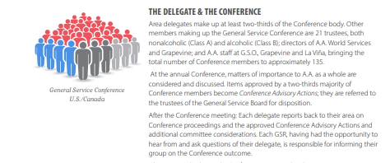
Conference Members

Slide 98
Conference Members

Slide 100
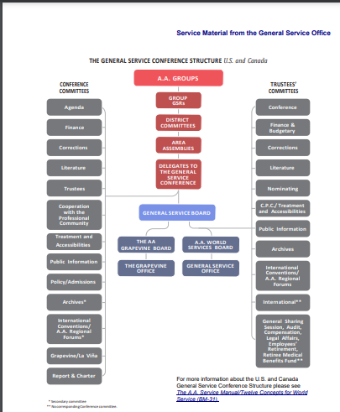

Slide 101
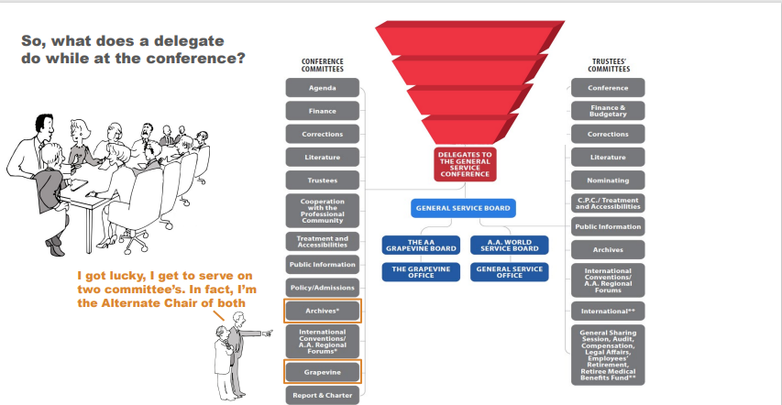
Tracy served on Treatment/Accessibilities

Slide 102
General Service Office
G.S.O. serves all A.A. groups in the United States and Canada,
offers services to A.A. overseas, especially in countries where there is no service structure.
as the “senior” office, it performs many functions that groups, districts, areas and intergroup/central offices cannot easily handle, serving as a clearinghouse and exchange point for the wealth of A.A. experience accumulated over the years,
coordinating a wide array of activities and services,
overseeing the publication, translation and distribution of A.A. Conference-approved literature and service materials.
G.S.O. also includes AA Grapevine and the many services and products it provides to the Fellowship

Slide 103
General Service Office
G.S.O. serves all A.A. groups in the United States and Canada,
offers services to A.A. overseas, especially in countries where there is no service structure.
as the “senior” office, it performs many functions that groups, districts, areas and intergroup/central offices cannot easily handle, serving as a clearinghouse and exchange point for the wealth of A.A. experience accumulated over the years,
coordinating a wide array of activities and services,
overseeing the publication, translation and distribution of A.A. Conference-approved literature and service materials.
G.S.O. also includes AA Grapevine and the many services and products it provides to the Fellowship

Slide 104
GSO Employees
The General Service Office is currently comprised of 100 employees (88 A.A.W.S./12 Grapevine) who provide a wide range of services to the Fellowship. While a number of G.S.O. employees are A.A. members, as required by the specific nature of their jobs, many of the professional services handled in the office are provided by nonalcoholic employees who are quite familiar with A.A. principles and practices.

Slide 105
Trustees
Amateurs
Boozers

Slide 106
Class A Trustees
NONALCOHOLIC (CLASS A) TRUSTEES There are seven (7) Class A trustees. They are nonalcoholic “friends of A.A.” — selected primarily for their professional experience, expertise and familiarity with A.A. and its program of recovery. They are a rich source of wisdom and perspective, and since they need not maintain anonymity, they are available to appear in public on behalf of A.A

Slide 107
Class A Trustees
NONALCOHOLIC (CLASS A) TRUSTEES There are seven (7) Class A trustees. They are nonalcoholic “friends of A.A.” — selected primarily for their professional experience, expertise and familiarity with A.A. and its program of recovery. They are a rich source of wisdom and perspective, and since they need not maintain anonymity, they are available to appear in public on behalf of A.A

Slide 108
Class B Trustees

Slide 109
Class B Trustees

Slide 110
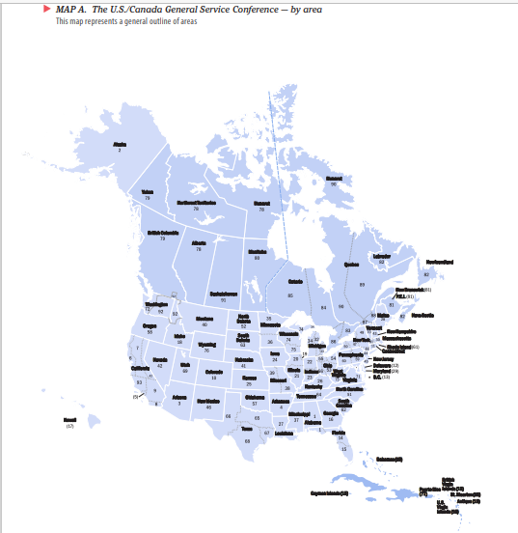

Slide 111
What about the Delegate?
As a delegate at the Conference, am I representing my area — and should I vote according to my area’s conscience?
This is addressed in Concept III, which states: “…Conference Delegates are primarily the world servants of A.A. as a whole, that only in a secondary sense do they represent their respective areas. Consequently they should, on final decisions, be entitled to cast their votes in the General Service Conference according to the best dictates of their own judgment and conscience at that time.” When delegates veer from what they know their area’s conscience to be, they are asked to report this to their area and the reasons why they voted as they did.

Slide 112
Delegate Responsibilities
In addition to the annual Conference meeting, the delegate is involved in all aspects of the Conference structure throughout the year.
Attend the annual Conference meeting fully prepared. Immediately upon election, every delegate is put on the G.S.O. mailing list to receive Conference materials and is given a password to the Conference dashboard maintained by G.S.O. to access important Conference-related information, including direct communications from the Conference coordinator and other G.S.O. employees. •
Communicate the actions of the Conference to area committee members and encourage them to pass on this information to groups and to intergroup/central offices. If an area is too large for the delegate to cover in person, they will ask area officers and committee members to share the load.

Slide 113
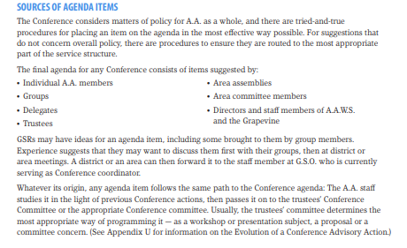

Slide 114
Process for Agenda Items AA Service Manual p. 164

Slide 115
Process for Agenda Items AA Service Manual p. 164

Slide 116
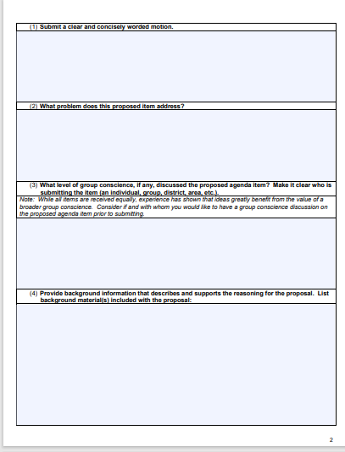
New Form

Slide 117
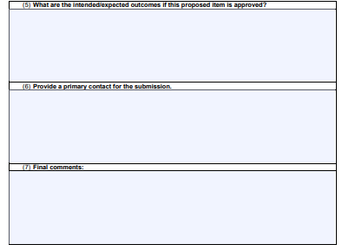

Slide 118
What Goes On at Conference?
A typical Conference lasts a full week, with sessions running from morning to evening.
The opening day features roll call, a keynote address, an opening dinner and a five-speaker A.A. meeting.
Business sessions from Sunday to Friday include committee meetings, presentations, workshops and new trustee elections.
Each delegate serves on one of the standing Conference committees, which meet early in the week and do the principal work of the Conference. (Some delegates also have a secondary committee assignment.)
The committees bring recommendations to the full Conference for consideration as possible Advisory Actions, and generally the last two days (or more) are devoted to discussion and voting on committee recommendations.

Slide 119
Conference Committees
Conference Committee discusses Agenda items in Conference Committees
Each Committee has ~ 8 members
GSO staff serve as Secretary for the Committee
Total time scheduled for Conference Committees= 8 hours Sunday – Wednesday
Presentation of Conference Committee Reports-
Wednesday evening-Thursday-Friday-Saturday

Slide 120
Agenda Items Possible Outcomes
Committee compiles a written report to present to full conference
Agenda item outcomes
No action
Committee Considerations
Recommit back to trustee’s committee for additional study
Recommendations – These are discussed and voted on by the full conference and, if passed, become Advisory Actions

Slide 121
Conference Approved Literature

Slide 122
Conference Approved Literature

Slide 123
Let’s Try This Out
8 Volunteers
One Conference Agenda Item
Let’s talk it through…

Slide 124
What We Covered Today
GSR Importance and Ways to Support
General Service Conference
Members
Delegate’s role at Conference
Schedule
Agenda items: Submission guidelines and possible outcomes
Committees- make-up, meetings, and reports
Conference Approved Literature

Slide 125
Resources
https://www.aageorgia.org/service-manualsguides.html

Slide 126
More Resources

Slide 127
And…More Resources
https://www.aa.org/m-39-advisory-actions
https://www.aageorgia.org/uploads/7/0/0/0/7000565/ga_service_manual__publisher_revised_6.23.23.pdf

Slide 128
Discussion/Sharing

Slide 129
Thank you for your Service and Participation!

