Slide 1
GEORGIA STATE SERVICE ASSEMBLY
JANUARY 2023
I AM CURRENTLY SERVING
AS YOUR PANEL 72 AREA 16 DELEGATE

Slide 2
73rd General Service Conference
“AA’s 3 Legacies
Our Common Solution”
EDW
This Photo by Unknown Author is licensed under CC BY

Slide 3
LITERATURE
GROUPED AS 1 ITEM FORWARDED TO THE CONFERENCE LITERATURE COMMITTEE
A MONITORED, “CLOSED” READING ROOM FOR CONFERENCE MEMBERS ONLY DURING THE 2023 CONFERENCE
.
32 PAI’S
Plain
Language
Big Book

Slide 4
LITERATURE
28 PAI’S
SUGGESTION
LITERATURE COMMITTEE CONSIDER FORWARDING THE ITEM TO ALL AREAS TO DISCUSS WHETHER TO EDIT AA’S COFOUNDER'S WORDS IN CURRENT LITERATURE. THE ITEM WOULD BE DISCUSSED BY THE FELLOWSHIP DURING THE 2023-2024 CONFERENCE YEAR AND CONSIDERED BY THE CONFERENCE LITERATURE COMMITTEE AT THE 2024 GENERAL SERVICE CONFERENCE.

Slide 5
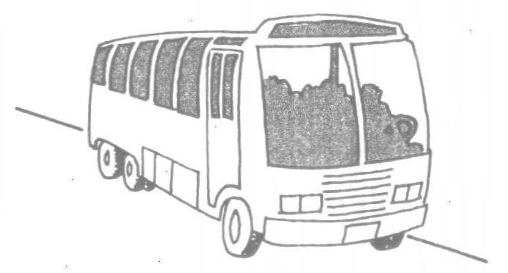
Communication Services Department: (CSD)
Meeting Guide App
GSO
PODCAST
GSO tours

Slide 6
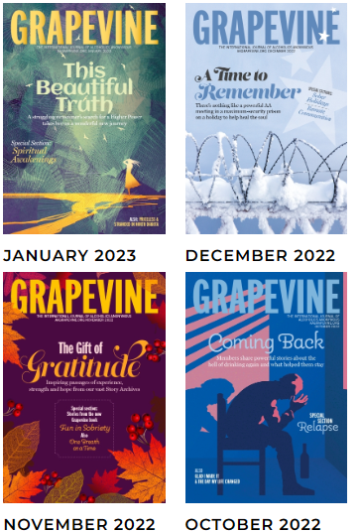
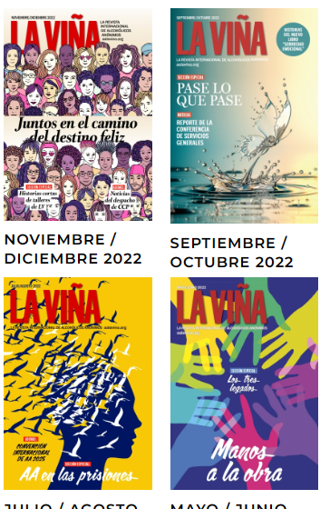
Grapevine and La Viña
AA Grapevine Upcoming Magazine Topics for 2023:
January: Spiritual Awakening,
February: Making Amends,
March: Getting Involved in AA Service
April: AA and Families.
Upcoming Grapevine Books, For the Spring:
Home Group Book.
AA La Viña Upcoming Magazine Topics 2023:
Jan – Feb: Prayer and Meditation,
Mar – April: People who Ordinarily Would Not Mix
May – June: Relapse Prevention.

Slide 7
Grapevine and La Viña
Grapevine Podcasts: Our AA Grapevine podcast program continues to grow - with a new episode each Monday
Podcast downloads have topped over 250,000 since inception.
Come check us out, Mondays, at: https://www.aagrapevine.org/podcast
Instagram Update, thru September 30, 2022:
AA Grapevine has 8,403 “followers” and La Viña has 1,012 “followers.”

Slide 8
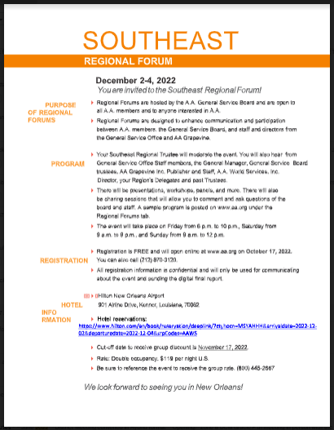
International Convention - Regional Forums

Slide 10
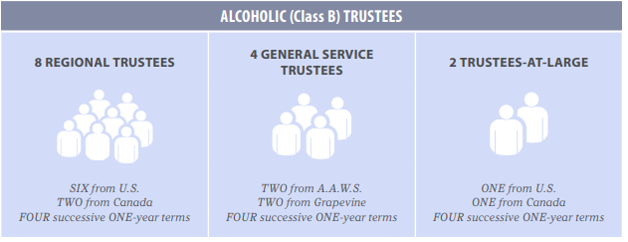
NOMINATING
Currently processing nominee information in preparation to elect the Trustee-At-Large, Canada and two regional trustees [Northeast and Southwest] and at the 73rd General Service Conference.
There are no vacancies to fill next year for Class A Trustees.

Slide 11
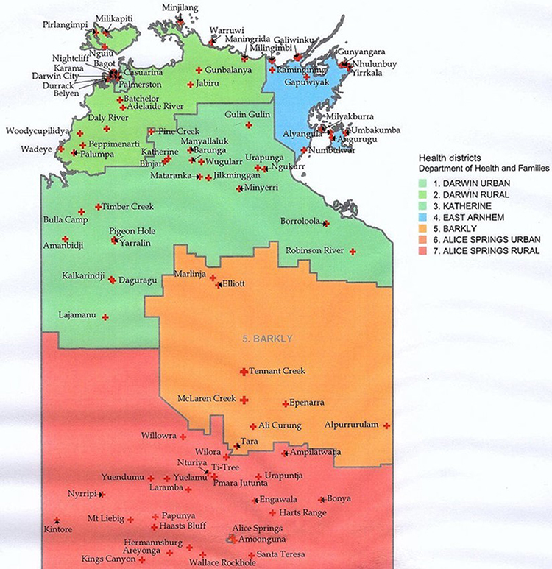
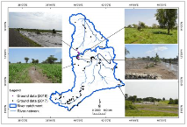
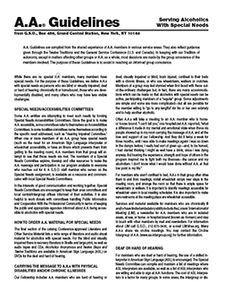
Treatment /Accessibilities/Loners
and Internationalists Meeting:

Slide 12
ONLINE GROUPS
ONLINE GROUPS
General Service Board’s Ad Hoc Committee on the Participation of Online Groups (POG) in the US and Canada Service Structure be included as background for the Conference Committee on Policy / Admissions in advance of the 73rd General Service Conference. The Chair of the ad hoc Committee confirmed that this request will be met

Slide 13
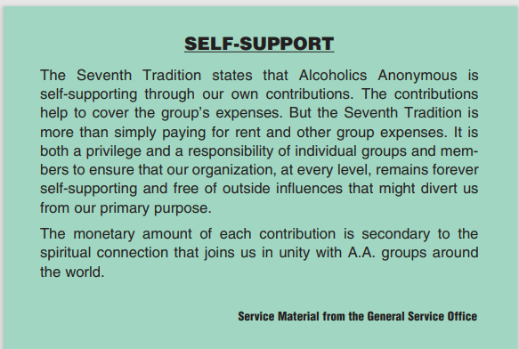
AAWS Report on Self-support
Updates
Incorporating Group search features in the online contribution portal,
Gathering stories received from GSO employees related to self-support, and
Compiling a report on Fellowship sharing on virtual baskets.
**One specific improvement mentioned is that the member will no longer see the Group search feature unless they are making a Group contribution. This will decrease confusion when an individual member contributes.

Slide 14
Throughout October, the Technology team launched a month-long cybersecurity awareness program through KnowBe4. Each week short videos and games are automatically emailed to GSO employees with the content focused on security

Slide 15
Public Information
MEMBERSHIP SURVEY
The 2022 AA Membership Survey is completing the Delegate data collection and processing phase.
Every AA Membership Survey has been a current snapshot of a limited number of the total AA group population, based on a moment in time.
The committee would like to thank all the Area Delegates for their service and participation. While there were some difficulties in conducting the survey, perhaps it’s a good time to remember … progress not perfection.

Slide 16
PLAIN LANGUAGE BIG BOOK
PUBLICATIONS OPERATIONS
Four new plain-language draft chapters have been delivered to the TABB Committee for review.
The Writer continues moving forward and meeting biweekly with Publishing Director and Editorial project editor Julia D.
PLAIN LANGUAGE BIG BOOK

Slide 17
CORRECTIONS
The chair appointed Dr. Al Mooney, Class A Trustee, to be the chair of the working group with the hopes of getting tablets into the Canadian facilities. The group is also inquiring about having virtual meetings.
The committee revisited the request forwarded by the 72nd Conference Committee on Corrections to update the section “Singleness of Purpose” in the Corrections Workbook to reflect current terminology. Updates will be made in both the workbook and all other literature that references these terms to ensure consistency.

Slide 18
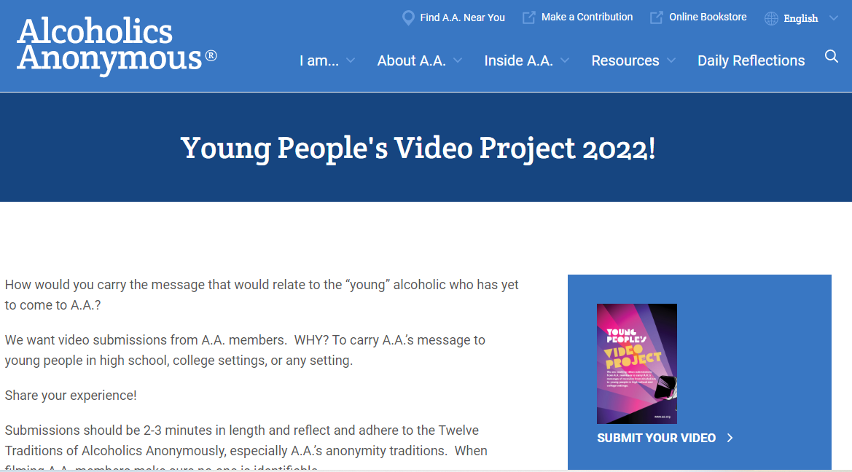

Slide 19
YOUNG PEOPLE
We have requested submissions of video content created by young people on how they carry the message to other Young People who may benefit from our life-giving solution.
Support is needed to help our young AA population
know about this project: The landing page with details, follows: https://www.aa.org/young-peoples-video-project
“Young People and AA”: The committee received a report from Publishing Department about the update of the pamphlet “Young People and AA” including the selection of a cover and the completion of the text.

Slide 20
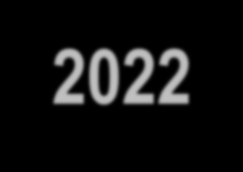
AROUND THE PICNIC TABLE
Finance 2023
UNAUDITED

Slide 21
FINANCES UNAUDITED
Finance and Budget:
Although unaudited, mid-year performance are in:
Contributions - Unaudited:
Year to September 30, 2022 Seventh Tradition Contributions are a little over $7.3 million.
This represents approximately 67% of the 2022 budget of $11,000,000 (with 75% of the year elapsed).
Literature - Unaudited:
September marked the fourth consecutive month of gross literature sales more than $1 million
- a milestone which has not been reached in several years.
However, supply chain disruptions throughout the worldwide paper and printing industries continue to unfavorably impact the manufacturing cost of A.A.W.S. literature.

Slide 22
FINANCES UNAUDITED
Expense - Unaudited:
Year to September 30 payroll and benefits expense is $6,890,148, which is 70% of the budget amount with 75% of the year elapsed (so, we are ahead of budget).
Total operating expense year to September 30 is $12,638,367 which is 72% of the budget amount with 75% of the year elapsed (a slightly favorable variance).
Overall Deficit or Surplus:
Our overall operating deficit year to September 30 is $545,496 compared to a budgeted deficit of $855,032. Given the circumstances, we are ahead of budget.
Reserve Fund - Unaudited:
As detailed by Kevin Prior, our non-alcoholic Treasurer of the General Service Board, our Reserve Fund continues to hover at just under 8 months (7.67 to be more specific) and we’ll be developing our forecasted General Service Board, AA World Service Board, and AA Grapevine Board budgets for 2023, respectively.

Slide 23
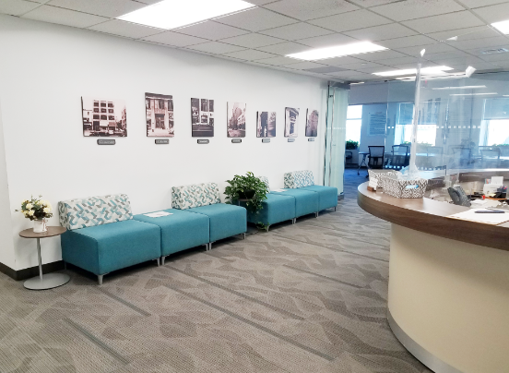
Office Operations:
The Fellowship Connection (FC) training video for Area Registrars is now completed! The video was posted on FC portal in October and a communication to this effect was sent out to Area Registrars. ed in 2023, pending budget approval.

Slide 24
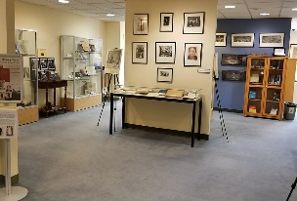
ARCHIVES COMMITTEE
Archives Committee: The Committee plans to curate a new digital exhibit on A.A.’s earliest pamphlets from the 1940s. Draft of digital exhibit completed in 2022: then to be translated in 2023 following archives budget approval.
Note: Archives projects are typically long-term, sometimes spanning years through completion. Please keep in mind that factors such as the inordinate number of research queries, and assisting onsite visitors or researchers impact our projected goals.
For those who plan to visit our GSO, a new exhibit commemorating the history of International Conference of Young People in A.A. (ICYPAA) was installed in September. If you travel with a group, please contact the Office ahead of time.

Slide 25
COOPERATION WITH THE PROFESSIONAL COMMUNITY
Pamphlet for Mental Health Professionals: Mental health professionals have agreed to be interviewed to provide the basis of the pamphlet. In addition, the working group provided suggestions for alternative formats to provide A.A. information to mental health professionals.
LinkedIn page shares information about AA and resources with professionals.
The committee reviewed a list of potential CPC exhibits for 2023. The committee reviewed the CPC exhibit evaluations from local A.A. volunteers and discussed the effectiveness of CPC exhibits at national professional conferences.
The fall 2022 issue of About AA is available
Box 459 Winter Issue is now available.

Slide 26
ROUND ROBIN DISCUSSION
LITERATURE ITEMS SUGGESTED TO BE FORWARDED TO AREAS FOR WIDER DISCUSSION LOOKING TOWARD SETTING A POLICY ON HOW AND WHETHER TO EDIT A.A. FOUNDER’S WORDS IN OUR CURRENT LITERATURE
MAY 2023 ASSEMBLY GSR WORKSHOP
AREA 16

Slide 27
THANK YOU!
delegate@aageorgia.org
478-960-4574

